Slide 1
Student assessment
Lisa Cottle, director of test administration

Slide 2
DIVISION Contact Information
Student Assessment Division
studenta@tea.state.tx.us
(512) 463‒9536

Slide 3
Student assessment program
TOPICS
Student Assessment Program Overview
STAAR
TAKS
TELPAS
Calendar
Roles
Materials
Test Security
Resources
®

Slide 4
program overview
State of Texas Assessments of Academic Readiness (STAAR)
grades 3‒8 mathematics
grades 3‒8 reading
grades 4 and 7 writing
grades 5 and 8 science
grade 8 social studies
end-of-course (EOC) in Algebra I, biology, English I, English II, and U.S. history

Slide 5
program overview
State of Texas Assessments of Academic Readiness (STAAR)
STAAR Spanish - grades 3‒5
STAAR L (online only) - grades 3‒8 (except for reading and writing)
- EOC (except for English I and II)
STAAR Modified - grades 3‒8 - EOC
STAAR Alternate - grades 3‒8 (system of teacher observations - EOC and evaluations during a testing window)

Slide 6
program overview
State of Texas Assessments of Academic Readiness (STAAR)
Student Success Initiative (SSI)
- students in grades 5 and 8 must pass STAAR mathematics and reading
to be promoted to the next grade
- students are provided with three testing opportunities
Graduation Requirements
- students must pass all five STAAR end-of-course assessments to meet
the testing requirements for a Texas diploma

Slide 7
program overview
State of Texas Assessments of Academic Readiness (STAAR)
Time Limits
- all tests except English I and II are to be administered within a four-hour
time period
- English I and II (combined reading and writing) will be administered in
one day ‒ time limit to be determined
Online Testing
- all EOC assessments are available online or on paper

Slide 8
program overview
Texas Assessment of Knowledge and Skills (TAKS)
TAKS and - exit level - English language arts,
TAKS (Accommodated) mathematics, science, and social studies
Graduation Requirements
- students who were enrolled in grade 9 in 2010‒2011 or earlier must
pass all four content area tests to meet the assessment requirements
for a Texas diploma

Slide 9
program overview
Texas Assessment of Knowledge and Skills (TAKS)
Time Limits
- TAKS tests are untimed
Online Testing
- all TAKS assessments are available online or on paper

Slide 10
program overview
Texas English Language Proficiency Assessment System (TELPAS)
TELPAS - grades K‒12 - English language learners classified as limited English proficient (LEP)
- assesses the progress English language learners in K‒12 make in
learning the English language in the domains of listening, speaking,
reading, and writing
- is a multi-faceted system that includes an online reading test, teacher
observations and rating of student performance in listening and speaking,
and the rating of student writing samples
- is assessed during a window

Slide 11
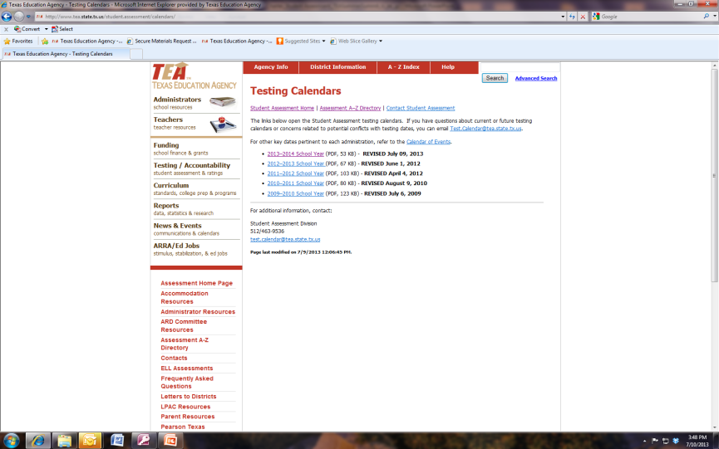
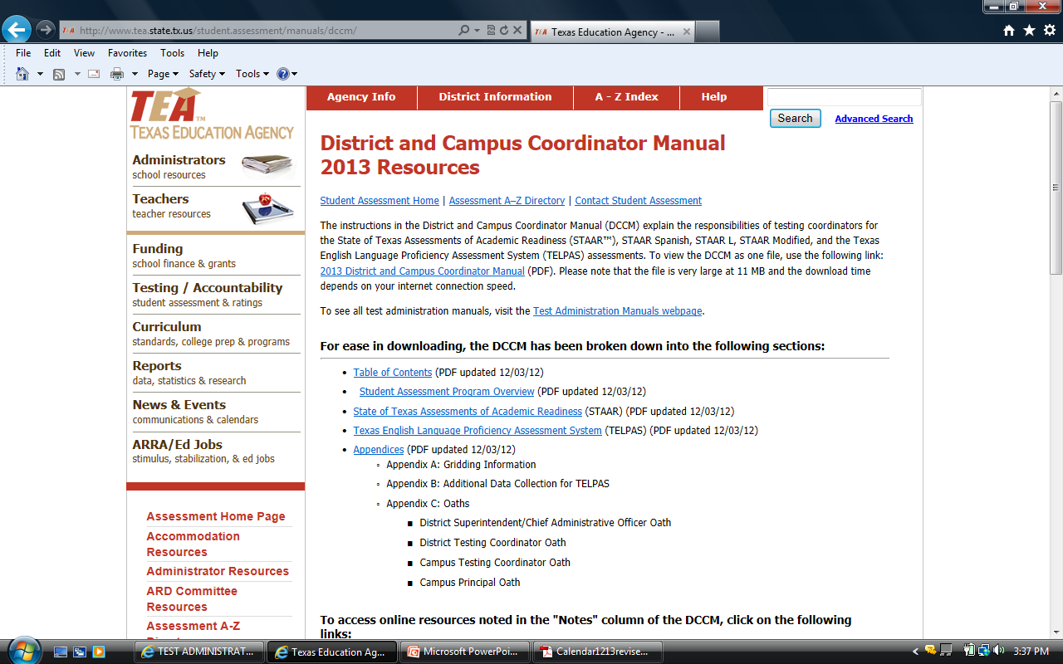
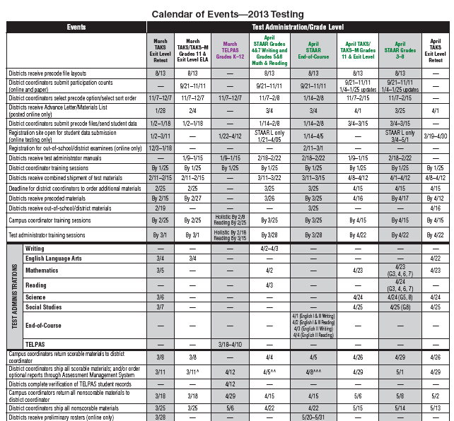
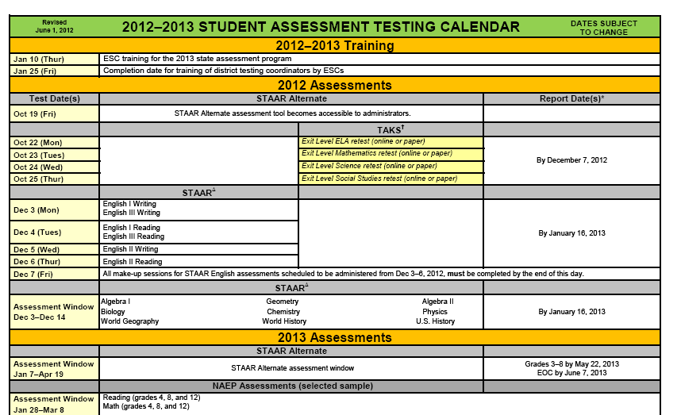
Calendar 2012‒2013 Calendars
http://www.tea.state.tx.us/student.assessment/calendars/
http://www.tea.state.tx.us/student.assessment/manuals/dccm/

Slide 12
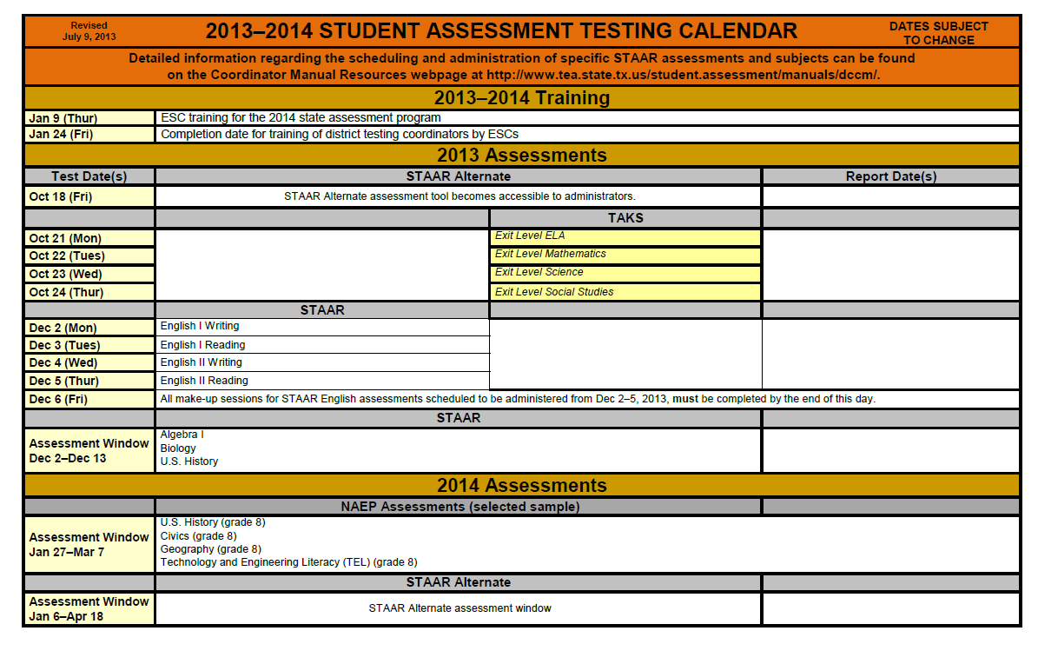
Calendar 2013‒2014 Calendars
http://www.tea.state.tx.us/student.assessment/calendars/

Slide 13
calendar
Scheduling of Tests
STAAR
- Charter districts should adhere to the testing dates as listed on the
annual Student Assessment Calendar.
- Specific testing dates are assigned for the administration of all STAAR
assessments in grades 3‒8 and for STAAR English I and II.
- STAAR Algebra I, biology, and U.S. history may be tested any day within
the assigned testing window.

Slide 14
calendar
Scheduling of Tests
STAAR
- If a conflict exits, charter districts are provided flexibility to change the
administration dates for reading, mathematics, science, and social
studies assessments in grades 3‒8 to accommodate local needs
(detailed in letter dated 7/22/11).
- Charter districts do not have the flexibility to change testing dates for
English I and II, or grades 4 and 7 writing.

Slide 15
calendar
Scheduling of Tests
STAAR Alternate
- Training window opens in the fall
- Test administration window runs from January‒April*
TAKS
- Each content-area test is to be administered on a specific date
- Testing opportunities are available in the 2013‒2014 school year in
October, March, April, and July*
TELPAS
- Activities begin in February
- Assessment window runs March‒April*
*see Student Assessment Calendar for specific dates

Slide 16
Coordination
Roles
Superintendent
- listed in AskTED
- ultimately responsible for maintaining the security and confidentiality of the
assessment program throughout the charter district
District Testing Coordinator
- listed in AskTED
- responsible for the maintenance of the security and confidentiality of the
assessment program throughout the charter district and for training staff
- serves as contact person with the testing vendor

Slide 17
Coordination
Roles
Campus Testing Coordinator
- responsible for training campus staff and for the maintenance of the security
and confidentiality of the assessment program on the campus
- coordinates test administrations at the campus

Slide 18
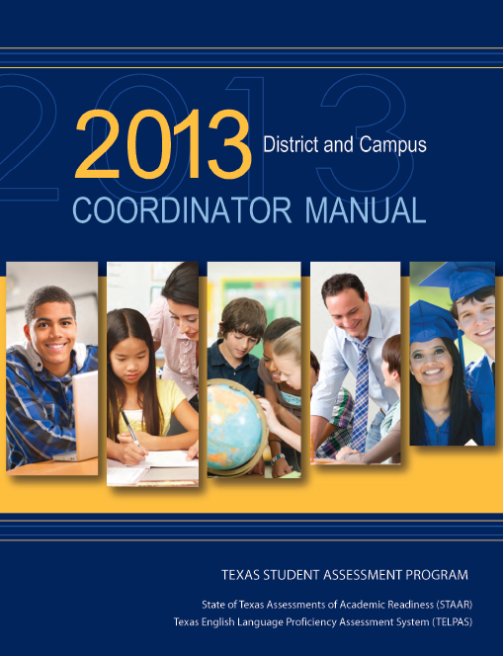
Materials
2013 District and Campus
Coordinator Manual
- STAAR
- TELPAS
http://www.tea.state.tx.us/student.assessment/manuals/dccm/

Slide 19
Materials
2013 District and Campus
Coordinator Manual
Action-oriented checklists
embedded in text
Guidelines for preparation,
administration, and return of test
materials

Slide 20
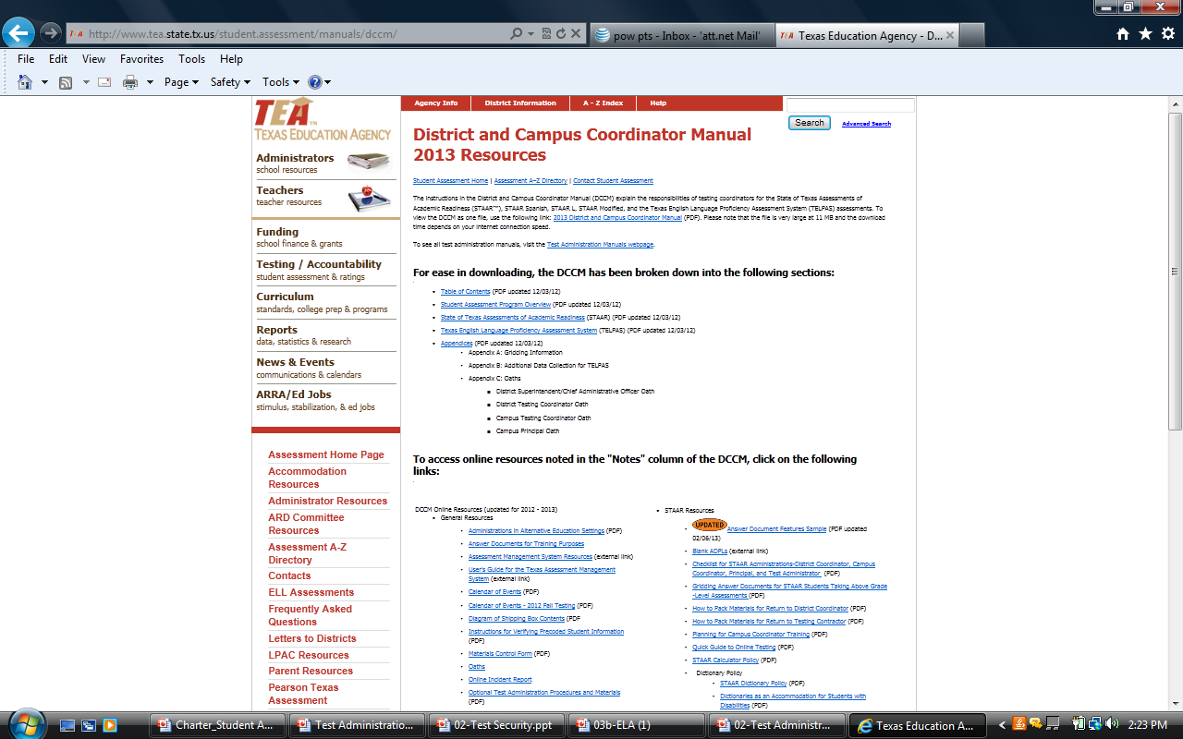
Materials
District and Campus Coordinator
Manual 2013 Resources
http://www.tea.state.tx.us/
student.assessment/manuals/dccm/

Slide 21
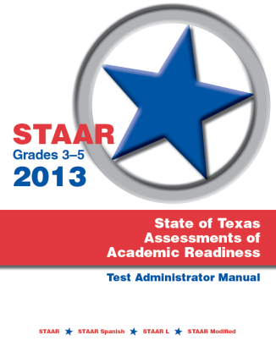
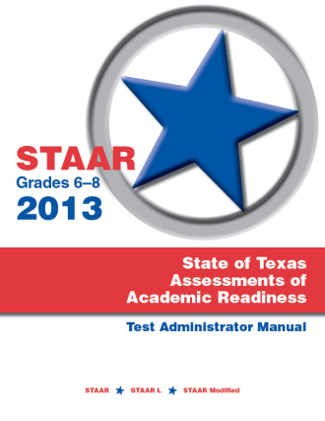
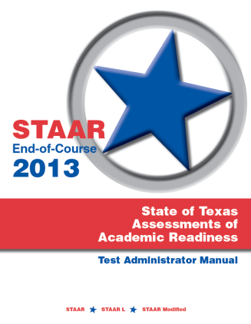
Materials
STAAR
Test Administrator Manuals
Three Test Administrator Manuals
- Grades 3‒5
- Grades 6‒8
- End-of-Course
Include general information and test
administration directions for STAAR,
STARR Spanish, STAAR L, and
STAAR Modified
http://www.tea.state.tx.us/student.assessment/staar/manuals/

Slide 22
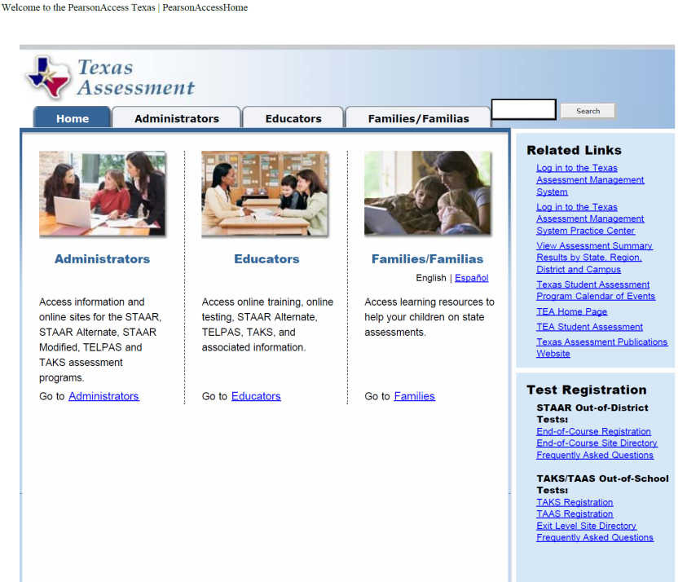
Materials
Texas Assessment
Management System (TAMS)
DTC will manage materials for state
assessments through the
TAMS website
Charter districts, once registered in
AskTED, will receive a password
automatically
http://www.texasassessment.com

Slide 23
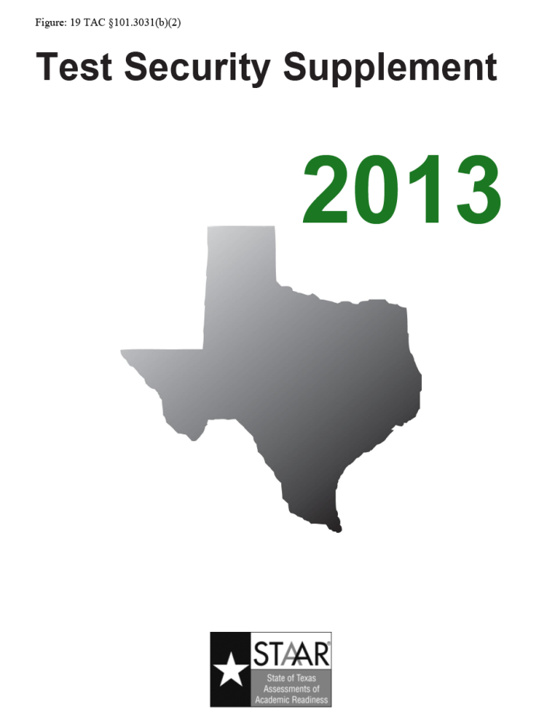
Materials
2013 Test Security Supplement
http://www.tea.state.tx.us/
student.assessment/security/

Slide 24
Test Security
Preventing Testing Irregularities
Train carefully
- issue manuals before training
- allow adequate time for training
- train all staff who will handle secure materials
- ensure that all staff involved in testing sign an appropriate Oath of Test
Security and Confidentiality

Slide 25
Test Security
Preventing Testing Irregularities
Practice good inventory control
- maintain a secure, limited-access storage area for materials
Refer to available resources for administration guidelines
Monitor during testing
Be available for questions
Call TEA Student Assessment Division for guidance

Slide 26
Test Security
Irregularity Types: Procedural and Serious
Procedural irregularities
- reflect minor errors or deviations in testing procedures
The charter district testing coordinator is responsible for determining the type of
irregularity, seeking guidance if needed from TEA on how to respond, and filing an
online incident report in a timely manner.

Slide 27
Test Security
Irregularity Types: Procedural and Serious
Serious irregularities
- constitute severe violations of test security or confidentiality
- require TEA to be contacted immediately
- can result in the individual(s) responsible being referred to the TEA
Educator Certification and Standards Division for consideration of
disciplinary action
The charter district testing coordinator is responsible for investigating, filing an
online incident report, and submitting required documentation along with a district
determination of events in a timely manner.

Slide 28
Test Security
Irregularity Types: Procedural and Serious
Serious irregularities include, but are not limited to:
- viewing a test before, during, or after an assessment
- scoring student tests
- discussing secure test content
- photocopying secure material without permission
- directly or indirectly assisting students
- tampering with student responses

Slide 29
resources
STAAR
http://www.tea.state.tx.us/student.assessment/staar/
STAAR L
http://www.tea.state.tx.us/student.assessment/ell/staarl/
STAAR Modified
http://www.tea.state.tx.us/student.assessment/special-ed/staarm/
STAAR Alternate
http://www.tea.state.tx.us/student.assessment/special-ed/staaralt/

Slide 30
resources
TAKS
http://www.tea.state.tx.us/student.assessment/taks/
TELPAS
http://www.tea.state.tx.us/student.assessment/ell/telpas/
Accommodations
http://www.tea.state.tx.us/student.assessment/accommodations/
Texas Assessment Management System
http://texasassessment.com/

Slide 31
resources
Student Assessment Division
Texas Education Agency
1701 N. Congress Avenue, Room 3-122A
Austin, Texas 78701
Phone: (512) 463-9536 Fax: (512) 463-9302

