Slide 1
Introduction to
Child Nutrition Programs (CNP)
How much you’ll learn about CNP in this presentation.
Texas Department of Agriculture
Food and Nutrition Division

Slide 2
Module Objectives: To identify
the agencies that regulate and administer Child Nutrition Programs (CNP)
Food & Nutrition’s Vision, Mission, and Cause Statements
the 6 CNP that can be operated by charter schools
the basics of how CNP are operated in charter schools
where to find additional resources, such as handbooks, manuals, and further guidance
Texas Department of Agriculture
Food and Nutrition Division

Slide 3
Agencies that regulate and administer CNP

Slide 4
Think of the relationship among the
U.S Department of Agriculture,
the Texas Department of Agriculture (TDA),
and TDA’s Food & Nutrition (F&N) division like this.
Texas Department of Agriculture
Food and Nutrition Division

Slide 5
The plate represents the United States Department of Agriculture (USDA) —
the federal agency that regulates CNP.
Texas Department of Agriculture
Food and Nutrition Division
Notes:
Authorized at section 17 of the National School Lunch Act (42 U.S.C. 1766). Program regulations are issued by the U.S. Department of Agriculture (USDA) under Title 7 CFR (covering all the Child Nutrition Programs) – specifically part 210 – The National School Lunch Program
‘‘It is declared to be the policy of Congress, as a measure of national security, to safeguard the
health and well-being of the Nation’s children and to encourage the domestic
consumption of nutritious agricultural commodities and other food, by assisting
the States, through grants-in-aid and other means, in providing an adequate
supply of food and other facilities for the establishment, maintenance,
operation, and expansion of nonprofit school lunch programs.’’
In 1998, Congress expanded the National School Lunch Program to include reimbursement for snacks served to children in afterschool educational and enrichment programs to include children through 18 years of age.
Richard B. Russell National School Lunch Act
Requires consistency with the latest Dietary Guidelines for Americans (DGA)
Healthy, Hunger-Free Kids Act of 2010
New/updated school lunch and breakfast meal patterns and nutrition standards based on IOM recommendations
Establish a final rule and date for compliance
Overview of major changes to better address dual threats of obesity and food insecurity/hunger that impact children today:
Reflects the most current nutrition science
Age/grade groups K-5, 6-8, and 9-12
narrower age/grade groups that better reflect the stages of growth and development in children and adolescents. These groups generally match how most school grades are configured and are consistent with the Institute of Medicine’s Dietary Reference Intake groupings which will result in more age-appropriate school meals.
3. Increased availability of fruits, vegetables, whole grains, fat-free/low fat milk
The Institute of Medicine studied children’s intake of fruits and vegetables and found that intake of dark green and red/orange vegetables and legumes was very low – less than 20% of the MyPyramid recommended amount. Total vegetable intake was only about 40 percent. Total fruit intake was about 80 percent of MyPyramid amounts in younger children but declined with age. Additionally, more than 50 percent of that fruit intake was in the form of juice versus whole fruit. Total intake of grains was close or exceeded MyPyramid amounts for all age groups but most of the grain products were refined
4. Four dietary specifications – calories, saturated fat, trans fat and sodium
Nutrient targets. They include total number of calories to respond to concerns about childhood obesity; percent of saturated fat and trans fat to again address obesity and children’s risk for cardiovascular disease later in life; and reductions in sodium to reduce the risk of various chronic diseases
Weekly average requirements
–Calories - Minimum and maximum calorie (kcal) levels by age group
–Sodium
–Saturated fat
Daily requirement
–Trans fat

Slide 6
The whole sandwich represents the Texas Department of Agriculture (TDA) — the state agency that administers USDA CNP within Texas.
The plate represents the United States Department of Agriculture (USDA) —
the federal agency that regulates CNP.
Texas Department of Agriculture
Food and Nutrition Division
Notes:
the Department provides States with general and special cash assistance and donations of foods (USDA Foods) acquired by the Department to be used to assist Contracting Entities in serving nutritious meals to children. USDA foods are “entitlement” foods and were valued at 22.25 cents for each meal served in FY2012.
In furtherance of Program objectives, participating schools shall serve lunches that are nutritionally adequate, as set forth by Federal regulations, and shall to the extent practicable, ensure that participating children gain a full understanding of the relationship between proper eating and good health.
Through agreements with School Food Authorities, States assist schools, RCCIs and other entities to serve nutritionally adequate lunches each school day

Slide 7
The whole sandwich represents the Texas Department of Agriculture (TDA) — the state agency that administers USDA CNP within Texas.
The meat represents Food and Nutrition (F&N) — the division of TDA that provides training and assistance to schools to help them implement and administer CNP according to USDA guidelines.
The plate represents the United States Department of Agriculture (USDA) —
the federal agency that regulates CNP.
Texas Department of Agriculture
Food and Nutrition Division

Slide 8
School Meals at TDA F&N
http://www.squaremeals.org/Programs.aspx
NEO
Nutrition Expertise, Training, Promotion/Outreach & Marketing
Business Operations (BOps)
Claims Reimbursement, Application Processing, Data
School Operations (SOps)
Compliance & Review, Program T.A., other Field Services
Program Improvement & Policy (PIP)
Interpretation & Communication of Program Policies & Regulations
Administration
Direction/Strategy, Resource Mgt, Oversight & Communications
Notes:
Community Operations not included because they are totally separate and for all intents and purposes not involved with School Meals Programs –
Exception – is that they do the compliance review/monitoring of Schools that are operating a traditional SFSP site.

Slide 9
sandwich
USDA and TDA’s F&N division work together to connect people in need with nutrition resources for success.

Slide 10
Q1
Q1
What is the relationship between TDA F&N and the USDA?
Did you catch all that?
— TDA and USDA have no relationship.
— TDA creates nutrition assistance programs for
Texas that are administered by the USDA.
— TDA administers the USDA’’s nutrition
assistance programs within Texas.
Texas Department of Agriculture
Food and Nutrition Division

Slide 11
F&N Mission, Vision, Cause Statements

Slide 12
A global example of
excellence and
empowerment
in providing nutrition assistance.
Food and Nutrition
Vision Statement

Slide 13
Food and Nutrition Mission Statement
Feeding the hungry and
promoting healthy lifestyles.

Slide 14
Ending hunger
by 2015.
Food and Nutrition Cause Statement

Slide 15
So, how do we
do all that?
TDA’s Food and Nutrition division administers
12 federal child and special nutrition programs.
Provide free or low-cost meals to children during the day
Safeguard health and wellbeing of children by providing nutritious meals and snacks
Establish and encourage healthy eating habits
Texas Department of Agriculture
Food and Nutrition Division
Notes:
Does TDA or F&N administer CNP? See sandwich slides to keep message consistent.
This ensures that participating children gain a full understanding of the relationship between proper eating and good health as well as participating in learning experiences that will improve their eating habits.

Slide 16
Child Nutrition Program (CNP) that charter schools can offer
NSLP
National School Lunch Program
SBP
School Breakfast Program
ASCP
Afterschool Care Program
FFVP
Fresh Fruit and Vegetable Program
SFSP
Summer Food Service Program
SSO
Seamless Summer Option
SMP
Special Milk Program
Notes:
ASCP –means a program providing organized child care services to enrolled school-age children afterschool hours for the purpose of care and supervision of children. Those programs shall be distinct from any extracurricular programs organized primarily for scholastic, cultural or athletic purposes.

Slide 17
National School Lunch Program (NSLP)
The National School Lunch Program (NSLP) provides lunch to more than 3 million Texas children enrolled in schools or living in residential child care institutions. The NSLP serves nutritious free or low-cost lunches to eligible students. Lunches must meet federal nutrition standards and are reimbursable to schools based on number of meals served.
Texas Department of Agriculture
Food and Nutrition Division
Notes:
CEs that participate in NSLP are given cash subsidies and USDA Foods for each meal served. In return, the CEs must:
Serve lunches that meet Federal requirements
Offer free or reduced price lunches to eligible children
The reimbursement rates effective July 1, 2012, through June 30, 2013 were:
Paid - $0.27
Reduced - $2.46
Free - $2.86
These rates change annually based on the CPI.
As of June 30 2012
School districts: 1,177
Schools: 8,571
Average Daily Participation lunch (September-May) 3,135,092
Lunches Served for the Year 565,991,415
Federal Reimbursement for Lunch $1,206,105,662
Total Number of Meals Served for the Year 892,750,682

Slide 18
Food Based
Menu Planning
1. Grain
5. Milk
2. Fruit
Vegetarian entrees
Culturally appropriate
meals
Scratch cooking
4. Meat/Meat Alternate
3. Vegetables
Notes:
Fluid Milk (FF flavored and unflavored, Skim or 1% unflavored only)
Dietary Specifications
Less than 10% of calories from Saturated fat
Minimum and maximum levels for calories by age/grade groups
Must meet sodium levels
No trans fat items allowed
USDA Foods
May be used in School Nutrition programs as long as the income generated is returned to the School Nutrition account
Must sign an agreement to participate but not required to accept food items
Part of your permanent agreement with TDA

Slide 19
School Breakfast Program (SBP)
The School Breakfast Program (SBP) provides breakfast to Texas children enrolled schools or living in residential child care institutions. The SBP serves free or low-cost breakfasts, that meet Federal nutrition standards, to eligible students. Texas state law requires that a school must participate in the SBP if at least 10% of their students are eligible for free or reduced-price meals.
Texas Department of Agriculture
Food and Nutrition Division
Notes:
May qualify for a higher “severe need” reimbursement: *Contracting Entities (CEs) may qualify and apply for Severe Need Breakfast reimbursement in addition to the regular breakfast reimbursement for each of their sites. Within a CE, some sites may be eligible for severe need funding and others may not. For a site to be eligible, at least 40 percent of its total lunches served in school year 2010-11 must have been free or reduced. There are instances where a new school may qualify for Severe Need Breakfast reimbursement.
10% Breakfast Texas law: if at least 10% of students enrolled in one or more schools in a district or open-enrollment charter school are eligible for free- and reduced-price breakfasts, the governing body of the district or the open-enrollment charter school shall participate in the breakfast program and make the benefits of the program available to all eligible students in the school.
The reimbursement rates effective July 1, 2012, through June 30, 2013 were:
Paid - $0.27
Reduced - $1.25
Free - $1.55
As of June 30 2012
Average Daily Participation breakfast (September-May) 1,678,520
Breakfasts Served for the Year 301,568,976
Federal Reimbursement for Breakfast $462,609,388

Slide 20
Benefits of
Breakfast
Less illness at school
Less absenteeism
More alert and ready to learn
Improved classroom behavior
Higher standardized test scores
Texas Department of Agriculture
Food and Nutrition Division
Notes:
Research indicators:

Slide 21
Food Based
Menu Planning
1. Fruit/Vegetable
Vegetarian entrees
Culturally appropriate
meals
Scratch cooking
3. Milk
2. Grain
Notes:
Fluid Milk (FF flavored and unflavored, Skim or 1% unflavored only)
Dietary Specifications
Less than 10% of calories from Saturated fat
Minimum and maximum levels for calories by age/grade groups
Must meet sodium levels
No trans fat items allowed

Slide 22
Afterschool Care Program (ASCP)
The Afterschool Care Program (ASCP) provides snacks for children who attend education or enrichment activities in an organized, structured and supervised environment that is open to all. Snacks provided by ASCP must meet nutritional standards.
Texas Department of Agriculture
Food and Nutrition Division
Notes:
ARM: “To qualify for Afterschool Care Program (ASCP),5 a CE must (1) be approved to operate the NSLP and (2) provide participants education or enrichment activities in an organized, structured, and supervised environment that is open to all. Nutritional Requirements for Snacks. Snacks provided by ASCP must offer two required food components. Portion sizes for different age groups vary.”
Organized athletic programs are not eligible for participation in the After School Snack Program
Athletic activities that are “open to all” and do not limit membership may participate in the ASCP.
The ASCP provides snacks to CEs on the same income eligibility basis as school meals. However, programs that operate in areas where 50% of students are eligible for free or reduced priced meals may serve all snacks for free.
Program can accommodate special needs or academically gifted children
The reimbursement rates effective July 1, 2012, through June 30, 2013 were:
Paid - $0.07
Reduced - $0.39
Free - $0.78
As of June 30 2012
Average Daily Participation snack (September-May) 144,356 154,944
Snacks Served for the Year 24,179,785 25,190,291
Federal Reimbursement for Snack $18,759,361

Slide 23
Fresh Fruit and Vegetable Program (FFVP)
The Fresh Fruit and Vegetable Program (FFVP) provides elementary school children with free fresh fruits and vegetables. The goal of FFVP is to create healthier school environments by expanding the variety of fruits and vegetables children experience and increasing children’s consumption of fresh fruits and vegetables.
Texas Department of Agriculture
Food and Nutrition Division
Notes:
TDA determine eligibility criteria based on Federal funding.
TDA then selects which schools may participate and extend invitations for these schools to apply. (this year’s list includes several charter schools)
Schools choose whether or not they would like to participate in the program.

Slide 24
Summer Food Service Program (SFSP)
The Summer Food Service Program (SFSP) provides children in low-income areas with meals during long school vacations, when they do not have access to school lunch or breakfast. It provides nutritious and free meals to children 18 and younger during summer months. School districts and other eligible sponsors may serve as summer feeding program sites.
Texas Department of Agriculture
Food and Nutrition Division
Notes:
There are two federally funded summer programs:
ARM: “Summer Feeding State Mandate. Public school districts in which 50 percent of the total enrolled students are eligible for free and reduced-price meals must operate or arrange for the provision of a summer feeding program. Public school districts may operate either the SSO or the Summer Food Service Program (SFSP) administered by the TDA.”
Charter Schools not required since populations come from larger cities
Summer Food Service Program (SFSP)
Available to schools and private non-profit entities

Slide 25
Seamless Summer Option (SSO)
The Seamless Summer Option (SSO) was created to feed children in low-income areas during the summer months. Nutrition standards for meals or snack served and claimed for reimbursement must meet the NSLP, SBP and ASCP requirements.
Texas Department of Agriculture
Food and Nutrition Division
Notes:
Seamless Summer Option (SSO)
SSO is allowed only for schools operating the NSLP
Incentive that allows schools to continue with menu pattern into the summer with no application process
ARM
“TDA administers the Seamless Summer Option (SSO)6 for CEs that participate in the NSLP and SBP. SSO is designed to encourage CEs to provide meals in low-income areas during summer and other school vacation periods. CEs serve meals free of charge to children 18 and younger. Reduced paperwork and administrative burden that is normally associated with operating different programs. Feeding sites for this program may include one or more open site(s) within the attendance zone of a qualifying school as determined by the school officials. Qualifying sites must be located in an attendance area with 50 percent or higher free and reduced-price eligible children.
Nutritional Requirements for the SSO. Nutritional standards for meals or snacks served and claimed must meet the NSLP, SBP, and ASCP requirements.”

Slide 26
Special Milk Program (SMP)
The Special Milk Program (SMP) provides reimbursement for milk served to children who do not otherwise participate in a federal child nutrition meal service program. The SMP is administered in non-profit child care institutions, summer camps, and non-profit schools that do not participate in NSLP, SBP, SFSP or the Child and Adult Care Food Program.
Texas Department of Agriculture
Food and Nutrition Division
Notes:
ARM
“Exception: A nonprofit child care institution or nonprofit school in which children do not have access to meal service through the NSLP, such as split-session kindergarten, is eligible to apply to participate in the SMP.
The SMP provides cash assistance to contracting entities to encourage the consumption of fluid milk by children and help defray the cost of providing milk to children.
Cash assistance includes general cash payments for milk served to children enrolled in the site.
To ensure the nutritional adequacy of milk served, the milk must meet the guidelines set by the USDA FNS.”

Slide 27
Q1
Q2
Which program offers nutritious free or reduced-priced lunches to eligible students?
Did you catch all that?
— School Breakfast Program (SBP)
— Afterschool Care Program (ASCP)
— National School Lunch Program (NSLP)
— Summer Food Service Program (SFSP)
Texas Department of Agriculture
Food and Nutrition Division

Slide 28
Q1
Q3
Which two programs provide meals during long vacations when children do not have access to school breakfast or lunch?
Did you catch all that?
— Afterschool Care Program (ASCP) and Fresh Fruit and Vegetable Program (FFVP)
— Summer Food Service Program (SFSP) and Seamless Summer Option (SSO)
— Afterschool Care Program (ASCP) and Summer Food Service Program (SFSP)
Texas Department of Agriculture
Food and Nutrition Division

Slide 29
Q1
Q4
Which program offers nutritious snacks during education or enrichment activities?
Did you catch all that?
— School Breakfast Program (SBP)
— Afterschool Care Program (ASCP)
— National School Lunch Program (NSLP)
— Summer Food Service Program (SFSP)
Texas Department of Agriculture
Food and Nutrition Division

Slide 30
Who can
participate?
— Any public or charter school student 18 years of age or younger
Who is eligible for free or reduced-price meals?
— Free: income at or below 130% of poverty line
— Reduced-price: income between 130% and 185% of poverty line
— Full price: income above 185% of poverty line
Notes:
At this time you may have some questions.
Jon: “So who can participate in these programs?”
Adrienne: “
Slide 1
Any public or charter school student of high school age and younger
Charter schools must follow same federal regulations
A student provided instruction from an elementary or secondary institution
Head Start children may participate as students
Child must be enrolled in an education unit and under 18 years of age
21 if enrolled in a Residential Child Care Institution (RCCI)
* U.S. citizenship not a factor in the determination of eligibility
Jon: “What determines whether a student is eligible to receive a free or reduced-price meal?”
Adrienne:
The following income eligibility guidelines are used to determine eligibility for free and reduced price meals or free milk for the nutrition assistance programs administered by TDA.
NSLP/SBP/SFSP: Eligibility may be based on total income and size (i.e., number of household members) of a participant’s household. If any member of the household receives Temporary Assistance for Needy Families (TANF), Supplemental Nutrition Assistance Program (SNAP) or Food Distribution Program on Indian Reservations (FDPIR) benefits, children are eligible for free meals.
SMP: Eligibility for free milk is based on total income and size (i.e., number of household members) of a participant’s household.
Reduced price meals - School Food Authority (SFA) cannot charge more than $.40 for lunch, $.30 for breakfast, or $.15 for snacks.
Process
1. Application issued to all students enrolled in CE
2. Household eligibility determinations conducted by CE
3. Serve reimbursable meals to eligible students
4. Count and claim students according to eligibility determination
5. Verification must be completed by Nov. 15 each year
Submitted to TDA by March 1, annually

Slide 31
How does our school get reimbursed?
— Ensure that all meals claimed are reimbursable
— Submit claims electronically each month to TDA
How does TDA monitor a school’s compliance with program requirements?
— Administrative Review process
— Occurs on a 3-year cycle
Notes:
Jon: “So how does a school receive financial reimbursement from the Texas Department of Agriculture?”
Adrienne: “
Ensure that all meals claimed
Were served to eligible students
Met program requirements
Have complete Food Production Records
Are accurately counted and claimed by category (free, reduced, paid)
Are backed up with adequate documentation
Submit claims electronically each month to TDA
Jon: “So how does TDA verify that a school is in fact serving reimbursable meals that meet Federal and state requirements and regulations?”
Adrienne: “
USDA requires the CRE to:
Ensure compliance with the requirements NSLP and SBP
Focus on Breakfast, Lunch, and Snack programs during each follow-up review
Mandated to occur at least once every three years

Slide 32
School Wellness Policy
CEs are required to complete and implement a Wellness Policy
Wellness Policy must include:
Goals for nutrition education, physical activity and other school-based activities
Nutrition guidelines for all foods available at each campus
Notes:
Wellness Policy
2004 Child Nutrition Reauthorization Act -> required all school districts that participate in SNP to adopt comprehensive LWP by School Year (SY) 2006-2007
A milestone in federal gov’t. addressing childhood obesity through school environments
Your local Education Service Center will help you develop a Wellness Policy that is relevant to your school’s priorities and meets the needs of your student population.
Your policy must:
Include goals for nutrition education, physical activity, and other school-based activities
Include nutrition guidelines for all foods available at each campus
Can be district-wide or at the campus-level
You are required to keep documentation to support that components of your policy are being met. Further guidance will be coming out soon regarding how to implement LWPs.
Strengthen local wellness policies so they become useful tools in evaluating, establishing & maintaining healthy school environments
Provide transparency to the public on key areas that affect the nutrition environment in each school
For example, a LWP that addresses bullying.

Slide 33
Texas Public School Nutrition Policy (TPSNP)
Concerned primarily with:
Foods of Minimal Nutrition Value
Competitive Foods
Fat
Portion Sizes
Beverages other than milk
* To promote healthier school environments
Review the TPSNP at:
www.SquareMeals.org
Notes:
The (TDA) Food and Nutrition Division has issued the Texas Public School Nutrition Policy (TPSNP) to promote a healthier environment in schools. This policy was the result of a collaborative effort utilizing the expertise from nationally recognized professionals who lent their time and knowledge to this important effort.
It addresses those foods sold outside of the reimbursable meal, with some exceptions.
Unless otherwise noted, all Texas public schools participating in the federal Child Nutrition Programs – (NSLP), (SBP) and (ASCP) must comply with these nutrition policies. Private schools and residential child care institutions are not required to comply with TPSNP.
These policies supplement federal policies defined by the United States Department of Agriculture’s (USDA) Food and Nutrition Service (FNS). As a result of local nutrition and wellness policies, school districts may have stricter nutrition guidelines.
FMNV: Refers to the four categories of foods and beverages (soda water, water ices, chewing gum, and certain candies) that are restricted by USDA under the Child Nutrition Programs.
Competitive Foods: Foods and beverages sold or made available to students that compete with the school’s operation of the NSLP, SBP and/or ASCP. This definition includes, but is not limited to, food and beverages sold or provided in vending machines, in school stores or as part of school fundraisers. School fundraisers include food sold by school administrators or staff (principals, coaches, teachers, etc.), students or student groups, parents or parent groups, or any other person, company or organization.
Fat: Schools and other vendors may not serve individual food items can contain no more than 23 grams of fat (one individual food item exception per week). No individual food items can exceed 28 grams of fat at any time (excluding peanut butter as part of a reimbursable meal). Schools must eliminate deep‐fat frying as a method of on‐site preparation for foods served as part of reimbursable school meals, a la carte, snack lines and competitive foods.
Criteria have been established for Elementary School, Middle School and High School campuses, such as Competitive Foods:
Elementary: Not allowed anytime anywhere on school premises until after the end of the last scheduled class
Junior: Not allowed anywhere on school premises from 30 minutes before to 30 minutes after meal periods.
High: Not allowed during meal periods in areas where reimbursable meals ae served and consumed.

Slide 34
Grocery Bag
full of Resources
TDA website www.SquareMeals.org
Administrator’s Reference Manual (ARM)

Slide 35
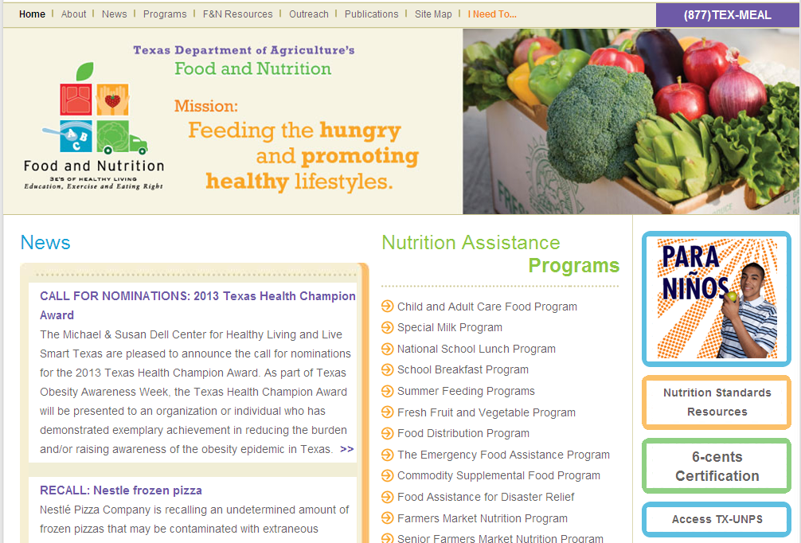

Slide 36
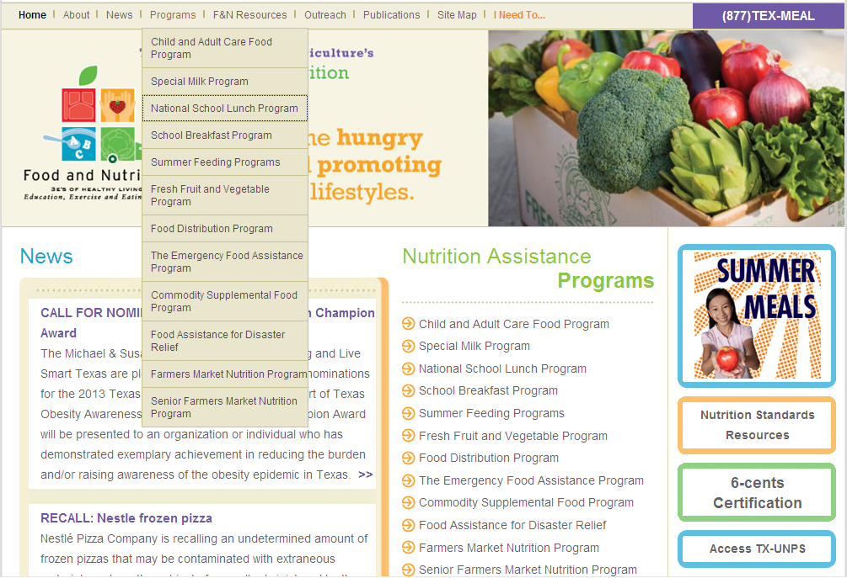

Slide 37
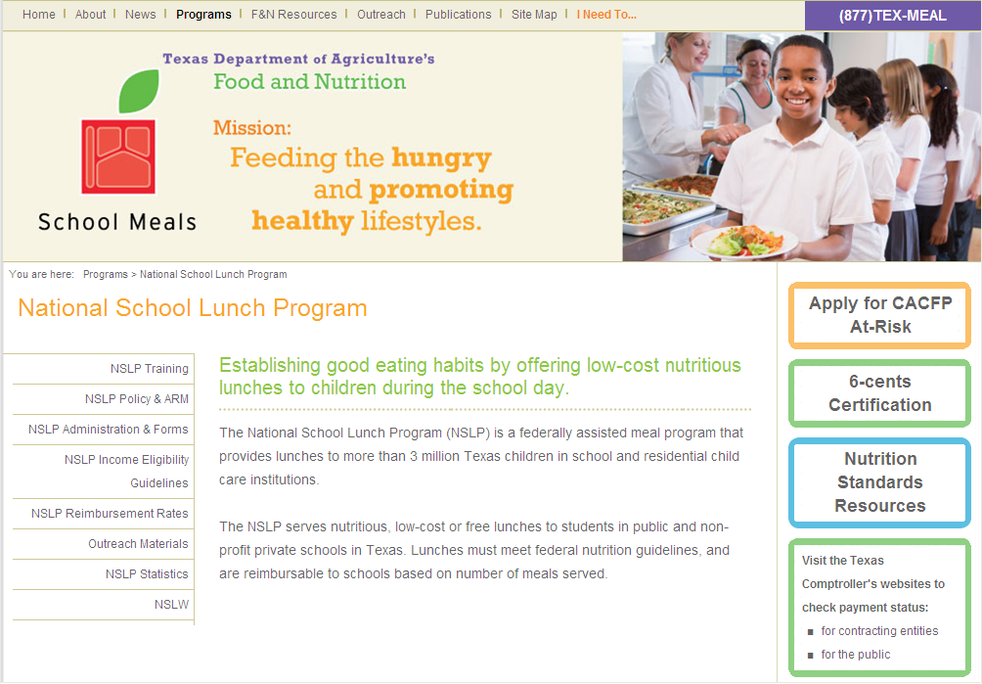

Slide 38
Grocery Bag
full of Resources
TDA website www.SquareMeals.org
Administrator’s Reference Manual (ARM)
USDA website www.fns.usda.gov

Slide 39
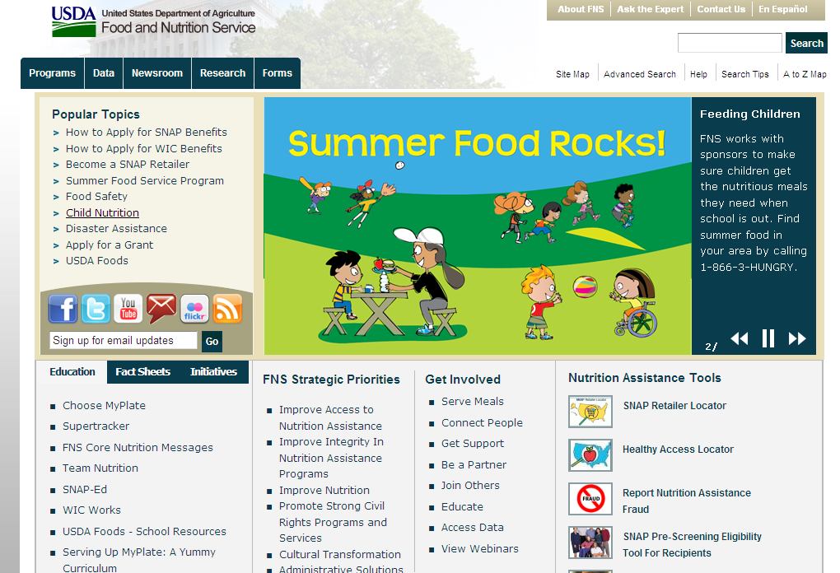

Slide 40
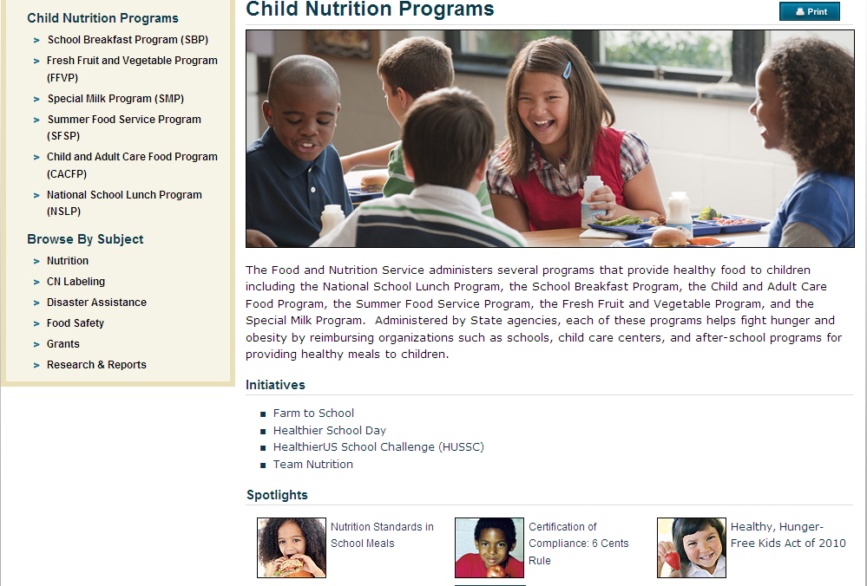

Slide 41
Grocery Bag
full of Resources
TDA website www.SquareMeals.org
Administrator’s Reference Manual (ARM)
USDA website www.fns.usda.gov
Education Service Centers (ESC)
Child Nutrition Program Specialists
Summer Workshop training

Slide 42
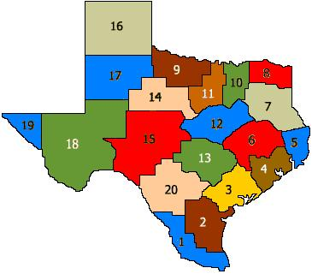
20 Education Service Center Regions (ESCs) in Texas
Notes:
Implement a School Nutrition Field Services Program
Training and T.A. to CEs administering School Meals Programs
Focus on TDA Training Connections Topics
Summer Workshops
Additional/special trainings
Report trainings (LBB)
Maintain documentation
Communicate with TDA
ESC Bi-Monthly, TETN, periodic emails
Other

Slide 43
Looking out to the future…
To participate in a CNP:
— Complete application through TX-UNPS at
http://www.texasagriculture.gov/Home/TXUNPS.aspx
— Call 1 (877) TEX-MEAL for more information
Notes:
Texas Unified Nutrition Programs System (TX-UNPS), which contracting entities (CEs) will use to file claims, submit applications and manage the nutrition programs they operate. The new system consolidates the CNPIMS, SNAPS and TCS computer applications into one web-based system and automates many time-consuming manual processes.

Slide 44
CONGRATULATIONS!
You have finished
Introduction to
Child Nutrition Programs(F&N)

Slide 45
The Texas Department of Agriculture’s Food and Nutrition Division is funded by the U.S. Department of Agriculture,
Food and Nutrition Service.
The U.S. Department of Agriculture prohibits discrimination against its customers, employees, and applicants for employment on the bases of race, color, national origin, age, disability, sex, gender identity, religion, reprisal, and where applicable, political beliefs, marital status, familial or parental status, sexual orientation, or all or part of an individual’s income is derived from any public assistance program, or protected genetic information in employment or in any program or activity conducted or funded by the Department. (Not all prohibited bases will apply to all programs and/or employment activities.)
If you wish to file a Civil Rights program complaint of discrimination, complete the USDA Program Discrimination Complaint Form, found online at http://www.ascr.usda.gov/complaint_filing_cust.html, or at any USDA office, or call (866) 632-9992 to request the form. You may also write a letter containing all of the information requested in the form. Send your completed complaint form or letter to us by mail at U.S. Department of Agriculture, Director, Office Adjudication, 1400 Independence Avenue, S.W., Washington, D.C. 20250-9410, by fax (202) 690-7442 or email at program.intake@usda.gov.
Individuals who are deaf, hard of hearing or have speech disabilities may contact USDA through the Federal Relay Service at (800) 877-8339; or (800) 845-6136 (Spanish).
USDA is an equal opportunity provider and employer.

