Slide 1
Fingerprinting and Background Checks for Charter School Employees
Jeannie Tomasek, fingerprinting manager

Slide 2
contact information
Jeannie Tomasek, Manager
jeannie.tomasek@tea.state.tx.us
512-463-5415
Customer Service
512-936-8400, Option 3

Slide 3
Purpose
The primary function TEA’s Fingerprinting Unit is to facilitate the process by which educators and non-educators submit their fingerprints and other required information to the State Board for Educator Certification (SBEC) and Texas Education Agency (TEA) in order to comply with statutory criminal history requirements.

Slide 4
TEC Chapter 22, Subchapter C
Chapter 22, Subchapter C, of the Texas Education Code (TEC) requires school districts and charter schools to ensure that certain individuals are fingerprinted in order to undergo a statutorily-required national criminal history records review, and that other individuals undergo a name-based criminal history record information review

Slide 5
Charter schools – Fingerprinting
In compliance with TEC Section12.1059 and TEC Chapter 22, Subchapter C, the following individuals must be fingerprinted and must undergo a national criminal history records review:
teachers, librarians, educational aides, administrators, and counselors (all certified roles) serving or employed by an open-enrollment charter school;
all substitute teachers, both certified and non-certified; and
all non-certified employees of an open-enrollment charter school hired after January 1, 2008.

Slide 6
Charter schools – Name Checks
In compliance with TEC Chapter 22, Subchapter C, the following individuals must undergo a name-based criminal history record information review:
all non-certified employees of an open-enrollment charter school hired before January 1, 2008;
interns/student teachers serving an open-enrollment charter school; and
volunteers of an open-enrollment charter school, excluding parents, grandparents and guardians, those accompanied on campus by a district employee, or individuals volunteering for a single event.

Slide 7
The fingerprinting of certified educators and school district and charter school employees is accomplished through a cooperative effort among:
Texas Education Agency
the Texas Department of Public Safety,
MorphoTrust (DPS contracted vendor),
All school districts and charter schools across Texas
School district and charter school employees

Slide 8
Educator Certification Online System (ECOS)
TEA’s online system where fingerprinting files are upload and the fingerprinting status of uploaded educators and non-educators can be viewed.
Access to ECOS is requested and granted through TEAL (TEA Log-in System)

Slide 9
DPS FACT Clearinghouse
Fingerprint results for those printed electronically are accessible in a database called the DPS FACT Clearinghouse
Employee records can be subscribed to and unsubscribed to.
Displays both DPS (statewide) and FBI (nationwide) criminal history results and photo of the individual.

Slide 10
STEPS TO COMPLIANCE with fingerprinting…
STEP 1 – ACCESS
STEP 2 – UPLOAD
STEP 3 – SUBMIT FINGERPRINTS
STEP 4 - REVIEW

Slide 11
STEP 1 – ACCESS
The charter school must maintain access to the Educator Certification Online System (ECOS) at all times for persons responsible for uploading employee information for purposes of fingerprinting.
The charter school must also maintain access to the DPS FACT Clearinghouse in order to review and adjudicate criminal histories for employees.

Slide 12
STEP 2 – UPLOAD
The charter school must upload required information to the ECOS for all newly hired employees and classroom substitutes.
Charter schools will be able to check the progress of each applicant throughout the process via ECOS.
For additional information on the upload process, please contact the TEA Division of Fingerprinting at (512) 936-8400, Option 3.

Slide 13
STEP 3 – SUBMIT FINGERPRINTS
The employee will schedule an appointment online with MorphoTrust USA (formerly L-1 Enrollment Services).
The charter school must follow-up with employees whose prints are rejected for poor print quality to ensure that the educator is re-printed.

Slide 14
STEP 4 – REVIEW
The charter school will automatically be subscribed to each employee in the DPS Clearinghouse that was printed with a TEA-issued Fast Fingerprint Pass after the individual has been uploaded and printed.
The charter school must subscribe to records in the DPS FACT Clearinghouse for all those previously printed through the TEA process to ensure they will receive subsequent arrest notifications (rapbacks) from DPS.

Slide 15
STEP 4 – REVIEW (continued)
Review the criminal histories in the DPS Clearinghouse and adjudicate them according to charter school standards. TEA will review these records based on provisions in TEC §22.085.
The charter school will continue their subscription in the DPS Clearinghouse to all employees and classroom substitutes during their term of employment with the charter school. The charter school must unsubscribe from records in the Clearinghouse as employees leave employment.

Slide 16
The upload process…
Charter school hires a new employee or substitute
Charter school uploads employee/sub information to ECOS
TEA emails charter school response data
Educator/employee is fingerprinted prior to beginning employment
Charter school subscribes in DPS Clearinghouse to any employees that were already “FP Complete”
Fingerprinting results are received by TEA
Charter school reviews results in the DPS Clearinghouse
Charter school unsubscribes to employees in the Clearinghouse as they leave employment

Slide 17
Categories of charter school employees
Certified Roles – Includes any certified employee of the charter who holds an active or inactive certificate or an active permit issued by State Board for Educator Certification (SBEC) regardless of the role they are serving in, AND anyone serving in a role that would require certification if employed in a traditional ISD.
Non-certified (in a non-certified role) – any charter school employee that does not hold certification issued by SBEC/TEA, and works in a role that would not require certification if employed in a traditional ISD.
Classroom Substitutes - A teacher who is on call or on a list of approved substitutes to replace a regular teacher and has no regular or guaranteed hours. A substitute teacher may be certified or noncertified.

Slide 18
Hiring a new employee/substitute for a charter school
To determine which upload category a new hire belongs, ask yourself:
Is this person a classroom substitute?
If YES – upload on substitute template (both certified and non-certified subs)
Does this person hold an SBEC/TEA issued certification, or is this person working in a role that would require certification if working in a traditional ISD?
If YES – upload on certified roles template
If you answered NO to both of the above questions….
Upload on the non-certified template
Remember to allow non-certified new hires that are applicants for certification to receive their FAST Fingerprint Pass through the certification application process, not through the upload process

Slide 19
Upload Formatting
Upload Columns
Last Name
First Name
Middle Name
DL State
DL Number
Birth Date
Email Address (Certified Only)
Campus Code (Certified Only)
Mailing Address (Non-cert and Sub only)
City (non-cert and Sub only)
State (Non-cert and Sub Only)
Zip Non-cert and Sub Only)
Telephone Number (Non-cert only)
Role Code (Charter School Certified Roles only)

Slide 20
TEA Response Data
Within 24-48 hours of the upload, the charter will receive an email response from TEA
For certified and sub uploads, a spreadsheet will be returned to the charter with a fingerprint status for everyone that was uploaded
Certified educators and subs must log on to ECOS to receive their fast pass
For non-certified employees (as well as non-certified subs), the charter will be sent a manifest listing the status for everyone uploaded as well as the fast fingerprint pass for anyone who is required to fingerprint

Slide 21
Subscribing in the DPS Clearinghouse
For each employee with an “FP Complete” status, the charter school must log on to the DPS Clearinghouse and subscribe to that employee in order to receive subsequent HIT notifications (rapbacks).

Slide 22
Scheduling an appointment to be fingerprinted
Once an employee receives his FAST Fingerprint Pass, an appointment should be scheduled with the DPS contracted vendor, MorphoTrust
At the appointment, each employee will receive a receipt that contains a TCN number used to track their prints; it is important that this receipt be retained as proof that the employee was printed

Slide 23
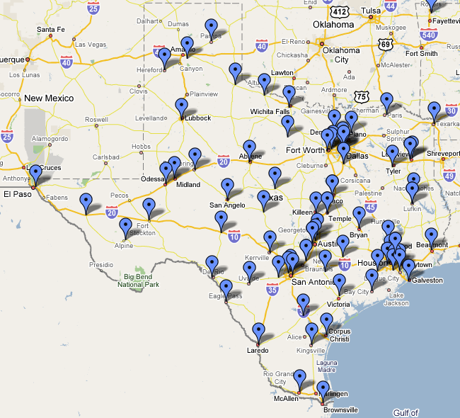
Safran MorphoTrust USA
Applicants may schedule an appointment at any of MorphoTrust’s fingerprinting locations throughout the state.

Slide 24
Fingerprinting Fees
Certified educators - $39.50 processing fee payable in ECOS + $9.95 scanning fee payable at MorphoTrust
Non-certified employees - $37.50 processing fee payable to MorphoTrust + $9.95 scanning fee, also payable to MorphoTrust

Slide 25
Rejections
Fingerprints may be rejected for poor print quality; MorphoTrust notifies employees of the need to re-print.
In the case of certified rejections, TEA also emails the educator, as well as the contact person at the charter school, with information regarding the rejection and the need for the educator to schedule an appointment to be re-printed.
In the case of non-certified rejections, TEA emails the contact person at the charter school that uploaded the employee with information regarding the rejection and the need for the employee to schedule an appointment to be re-printed.
Rejected prints in no way suggest that the educator may have a criminal history.

Slide 26
Rejections Continued
Fingerprints may be rejected by the FBI only twice, in which case an educator would only be required to be re-printed once (if both rejections are FBI rejections). If a DPS reject is also present, it is possible that an educator might have to be re-printed more than once.
Fingerprints may be rejected by DPS as well as FBI, but TEA does not receive notification of DPS rejections. Educators whose prints are rejects by DPS will receive notification from MorphoTrust only.
Once fingerprints have been rejected by the FBI a second time, an FBI Name Search is initiated by TEA. The educator and the district are not notified of the second rejection since there is no further action required on the part of the educator or the district.

Slide 27
Fingerprinting Results Received
Typically fingerprinting results are received by TEA 3-5 days after the fingerprinting appointment (if a rejection of fingerprints has not occurred)
Once results are received, an “Fingerprint Complete” status can be seen on the Educator Certification online “green screen”
The charter school will also be able to view the results of the applicant’s fingerprinting in the DPS Clearinghouse

Slide 28
Adjudication of Criminal Histories
As results appear in the Clearinghouse, the criminal histories should be reviewed by someone at the district level
Pay attention to subsequent arrest notifications called ‘rapbacks’.
TEA receives rapbacks on certified educators, but not on non-certified employees; if you aren’t looking at those, no one is!!!

Slide 29
CONTRACTOR/CHARTER SCHOOL RESPONSIBILITIES
Contractor should certify to the school district or charter school that they are compliant with fingerprinting their employees.
Charter schools may subscribe to the records of contractors/subcontractors employees that are subject to fingerprinting.
Charter school should unsubscribe to records in the FACT Clearinghouse when the contract or the employment has terminated.

Slide 30
CONTRACTED CLASSROOM SUBSTITUTES
Contracted employees are fingerprinted through a process facilitated by DPS and should not be uploaded to TEA as are employees
The only exception to the contractor process through DPS is that charters that contract substitute teachers and teacher aides SHOULD upload contracted subs to TEA using the SUB upload. Substitute teachers must be adjudicated through TEA!!!

Slide 31
DPS CONTACT INFO
Contractors must contact DPS to be set up with a secure site account.
Email: FACT@txdps.state.tx.us
Phone: (512) 424-2365, Option 2

Slide 32
FP staff contact info
Jeannie Tomasek, Manager
jeannie.tomasek@tea.state.tx.us 512-463-5415
April Carmichael, Program Specialist
April.carmichael@tea.state.tx.us
Baerbel Cleveland, Program Specialist
Baerbel.cleveland@tea.state.tx.us
Beatrice Avalos, Program Specialist
Beatrice.avalos@tea.state.tx.us
Pamela Coy, Customer Service Representative
Pamela.coy@tea.state.tx.us
Customer Service 512-936-8400, Option 3

