Slide 1
Instructional Continuity Texas Home Learning Model April 6, 2020

Slide 2
Home Learning Resource Vision
Create multiple Home Learning models that meet specific district needs and allow for contingency planning during school closures.
For contingency planning only:
Home Learning 1.0
Finish out School Year
Home Learning 2.0
Summer School Bridge
Home Learning 3.0
2020-21 School Year
Purpose: To support students in finishing out school with daily and weekly schedules available online and in print format.
Approach: Prioritize identifying freely available, parent friendly resources, printable in high volumes.
Timing: 8 weeks of learning (approx. April – mid-June)
TODAY’S FOCUS OF DISCUSSION

Slide 3
Home Learning Resource Vision
Create multiple Home Learning models that meet specific district needs and allow for contingency planning during school closures.
For contingency planning only:
Home Learning 1.0
Finish out School Year
Home Learning 2.0
Summer School Bridge
Home Learning 3.0
2020-21 School Year
Purpose: To provide students with support to prepare them for next academic school year.
Approach: Improve 1.0 version, with an emphasis on helping students access high quality text sets and novels at discounted state rates to accompany home learning plans.
Timing: 4 – 8 weeks of learning
OBTAIN DISTRICT FEEDBACK NEXT WEEK TO BETTER UNDERSTAND NEEDS

Slide 4
Long Term Vision
Create multiple Home Learning models that meet specific district needs and allow for contingency planning during school closures.
For contingency planning only:
Home Learning 1.0
Finish out School Year
Home Learning 2.0
Summer School Bridge
Home Learning 3.0
2020-21 School Year
Purpose: To launch new school year in situation where Home Learning is continued into the fall.
Approach: Improve 2.0 version by aligning home model to school model to provide continuous learning during closures.
Timing: Prepare from start of school year (or at any point during school year) to follow full-year Scope and Sequence for indefinite timeline.
TO BE DISCUSSED IN COMING WEEKS

Slide 5
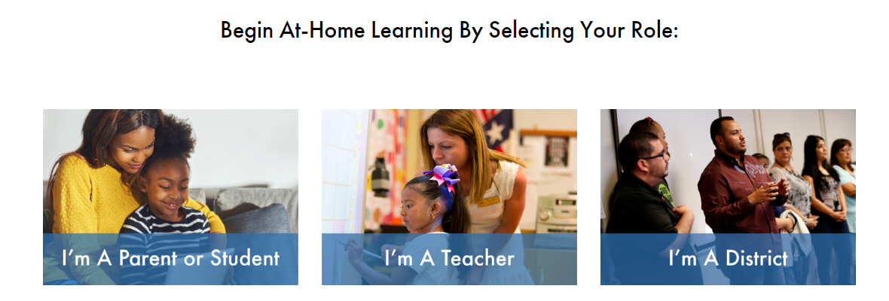
Users Can Select Their Role

Slide 6
Parents Can Select Online or Printed

Slide 7
Parents Also Select Grade of Child (all grades will be available)

Slide 8
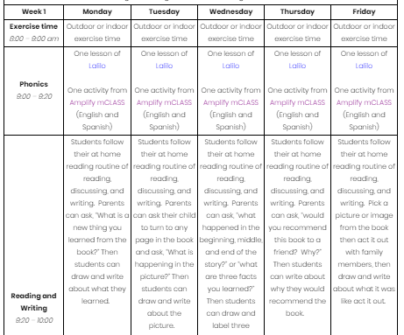
Each Grade Has Two Sets of Resources in Print and Digital
One-time Set-Up Instructions
Weekly and Daily Step-by-Step Schedules
STEP 1: Complete One-Time Set-Up to Create Accounts for Digital Resources
STEP 2: Review Summary of Home Learning Goals and Overview of Parent Role
STEP 3: Establish Your Daily Schedule

Slide 9
Teacher Guidance to Support Home Learning Model
Includes teacher guidance for how to work with students using online and print materials.

Slide 10
District Use Is Completely Optional and May Include:
Adopt Texas Home Learning as District Resource
Modify Texas Home Learning Plans for Local Context
Benefits:
Send resource directly to parents/teachers
Order grade level print packets to be shipped directly to students
Focus resources on supporting quality implementation
Considerations:
Cannot adapt learning plan based on local needs
Benefits:
Use existing templates and substitute resources as needed to meet local needs
Incorporate existing home learning guidance into model
Considerations:
Cannot access statewide printing if changes are made
Districts may also continue their existing plans and do nothing with this site.

Slide 11
Questions for Consideration of Use
Adopt Texas Home Learning as District Resource
Modify Texas Home Learning Plans for Local Context
A district may consider adopting Texas Home Learning (without changes) if:
District is currently offering limited daily and weekly guidance to parents and teachers in all core subjects
Students would benefit from building strong daily routines and learning structures to last them through end of year
Parents are seeking additional support and guidance for home support
District does not have solution in place to support families that do not have access to internet and/or devices (and need print materials)

Slide 12
Questions for Consideration of Use
Adopt Texas Home Learning as District Resource
Modify Texas Home Learning Plans for Local Context
A district may consider modifying Texas Home Learning locally if:
Home Learning resources do not meet the specific needs of the local student population
Students have access to strong instructional materials that support students with home learning
Districts have access to local print and distribution services they can leverage to reach families that do not have access to internet and/or devices (and need the modified print materials)

Slide 13
Texas Home Learning Resources
What is available today?
Complete Week 1 Daily Schedules for PreK – Grade 5 for Online Resources
Complete Week 1 Daily Schedules for PreK – Grade 5 for Print Resources
Explore now at www.TexasHomeLearning.org
What is available by the end of the week?
Complete Week 1 Daily Schedules for Grades 6 – 12 for Online and Print Resources
Additional weekly schedules added for PreK – Grade 5
What is available by end of next week?
Complete learning plans for all grades for online and print resources
Downloadable PDFs of grade level print packets

Slide 14
How To Access Statewide Printing Services
What’s included in statewide printing?
Districts pay a per student amount for a grade level print packet that includes 10 weeks of daily schedules and supporting resources for students and parents Note: Pricing info available next week, and districts will likely be able to request reimbursement for purchase
How does it work?
A district downloads .cvs template from TEA website, completes data pull of student mailing addresses using template, and submits to TEA and/or vendor
TEA accepts print orders on a first come first serve basis
Once pricing is finalized, TEA confirms final charge with districts for approval
Districts submitting addresses by end of week should have households receiving packets by first week of May

Slide 15
Example of Template to Request Printing

Slide 16
NOTICE AND DISCLAIMER
The documents and links included on this webpage are provided as a resource only. This information is intended to assist in the delivery of educational resources in this time of public crisis. Any references contrary to the Texas essential knowledge and skills (TEKS) or inconsistent with requirements to deliver the TEKS are incidental. The overall purpose and message of instruction must be based on the TEKS, not any other set of standards or viewpoints. Schools retain the responsibility for providing education to their students and consulting with their legal counsel to comply with legal and constitutional requirements and prohibitions.

