Slide 1
Texas Home Learning 3.0 August 19, 2020

Slide 2
THL 3.0 addresses COVID-slide and provides solutions to three primary challenges
Texas Home Learning 3.0…
Provides support to educators through instructional materials, technology solutions, and professional development to help lighten the load
Educator capacity
Educators have a lot to take on in a new educational environment
Texas Home Learning 3.0…
Will give free access to PreK-12 standards-aligned materials, customized to Texas, that are designed for continuity between remote and in-classroom environments
Materials for hybrid and remote settings
Traditional materials are more often designed for a brick-and-mortar classroom
Limited resources
The budget is tight
Texas Home Learning 3.0…
Is freely accessible to all public schools in Texas and provides budget flexibility to address local priorities

Slide 3
What is different about THL 3.0?
 | THL 1.0 and 2.0 | THL 3.0
What is it? | A crisis response of online resources and pdf packets. | A crisis response of tools including an LMS and year-long instructional materials.
Who is it for? | Designed as family and student-facing resources for guiding students outside of classroom without support of a full-time teacher. | Designed for teachers and districts to implement and, like any instructional materials, requires a skilled educator to be successful.
How do I access it? | TexasHomeLearning.org linked to online resources and customizable pdf packets. | However works best for your system. You can access a buffet of options that are designed to seamlessly integrate with a wide variety of scenarios and models.
Do I have to use it? | No, Texas Home Learning is completely optional and can be used in part or in whole.

Slide 4
THL 3.0 is an optional, aligned suite of resources that educators can use fully or in-part in the new learning environment
Texas Home Learning 3.0
INSTRUCTIONAL MATERIALS
TECHNOLOGY
PROFESSIONAL DEVELOPMENT
PreK-12 digitized, standards-aligned curricular content customized for Texas and the current learning environment
Suite of technology tools including a learning management system to support student engagement and instructional collaboration
Content and technology focused professional development to support educators with implementation both in classroom and remote settings
Districts may optionally adopt none, part, or all of any of the three components above

Slide 5
TEA has negotiated a statewide license for Schoology for all interested LEAs for two years
Districts must begin using Schoology anytime between today and March 1st, 2021 to benefit from license
License allows for integration with existing platforms, forthcoming THL instructional resources and other products as needed
Current Schoology customers may pause current contract to benefit from additional 2 years of LMS
Free two-year license
for Schoology LMS for any interested LEA paid for by TEA
Participating LEAs can choose to continue use of Schoology after the two years with a paid license
Go to www.powerschool.com/texas to learn more and sign up today!

Slide 6
THL 3.0 is an optional, aligned suite of resources that educators can use fully or in-part in the new learning environment
Texas Home Learning 3.0
INSTRUCTIONAL MATERIALS
TECHNOLOGY
PROFESSIONAL DEVELOPMENT
PreK-12 digitized, standards-aligned curricular content customized for Texas and the current learning environment
Suite of technology tools including a learning management system to support student engagement and instructional collaboration
Content and technology focused professional development to support educators with implementation both in classroom and remote settings
Districts may optionally adopt none, part, or all of any of the three components above

Slide 7
Texas Home Learning is being built to address this crisis
THL 3.0 curricular resources are being selected through a competitive solicitation process based on ability of publisher to develop high quality, TEKS-aligned instructional materials designed for flexibility in this new learning environment and accessible to all learners
No off-the-shelf curriculum is built for the unprecedented nature of the current situation for Texas schools
THL curricular resources are being developed specifically for Texas schools in this new learning environment
THL 3.0 curricular materials will undergo a rigorous review process to confirm alignment with TEKS and quality standards
Texas teachers will be involved in the review process before the release of each set of materials to interested districts
Continuous improvements will be made to the materials, informed by feedback from Texas teachers and other stakeholders

Slide 8
THL curricular resources are being developed specifically for Texas schools in this new learning environment
Develop
THL curricular resources are being developed specifically for Texas schools in this new learning environment
Review
Texas teachers will be involved in a TEKS and quality review process before release of each set of materials
Continuous improvements will be made to materials on ongoing basis
Release
Once approved, materials will be available through Schoology, as standalone resources or through other learning or content management systems
Support
Support district adapt or adoption decisions
Product specific webinars and onboarding trainings
Ongoing product improvements and supports for implementation

Slide 9
THL curricular resources are being developed specifically for Texas schools in this new learning environment
Develop
THL curricular resources are being developed specifically for Texas schools in this new learning environment
Review
Texas teachers will be involved in a TEKS and quality review process before release of each set of materials
Continuous improvements will be made to materials on ongoing basis
Release
Once approved, materials will be available through Schoology, as standalone resources or through other learning or content management systems
Support
Support district adapt or adoption decisions
Product specific webinars and onboarding trainings
Ongoing product improvements and supports for implementation

Slide 10
THL 3.0 offers free access to TEKS-aligned, digitized resources to be facilitated by teachers that are customized for Texas
Each grade level and subject resource is customized to Texas and includes:
Districts/schools can choose to adopt any portion or subset of the materials as they see fit
Unit plans and daily lesson plans aligned to Texas standards
Formative & summative unit assessments
Subject | Grades Offered
Integrated Pre-Kindergarten | Pre-K
Math | K through 12th grade
English Language Arts and Reading* | K through 12th grade
Spanish Language Arts and Reading | K through 5th grade
Science | K through 5th grade
Social Studies | K through 5th grade
College Prep Math and English | 12th grade
Dyslexia Tools & Speech Therapy | All Grade Levels
Teacher, student, and family supports
Digital format with printing capability
Built in progress monitoring
Accessibility supports for all learners
*Includes foundational skills and phonics in K-2

Slide 11
THL 3.0 Curricular Resources Are Digitized and Designed for the New Learning Environment
Component
Value for Educators
TEKS-Aligned Plans
Full sets of TEKS-aligned Unit Plans and Lesson Plans ready for teachers to adopt or adapt
Assessment Tools
Formative and Summative Assessments provide an opportunity for teachers to easily see what students know
Teacher & Student Supports
Saves teachers precious time and energy by providing quality lesson plans, teacher guides, and learning materials for students
Digital Format
Easily shift between in-person and remote instruction with built-in flexibility for the uncertainties of this school year
Progress Monitoring
Embedded progress monitoring allows teachers to manage student learning, understand progress, and continuously adjust instruction
Adaptable for All Learners
Adaptive software programs ensures all students receive the right content at the right time to meet their individual learning needs

Slide 12
THL 3.0: Math Preview

Slide 14
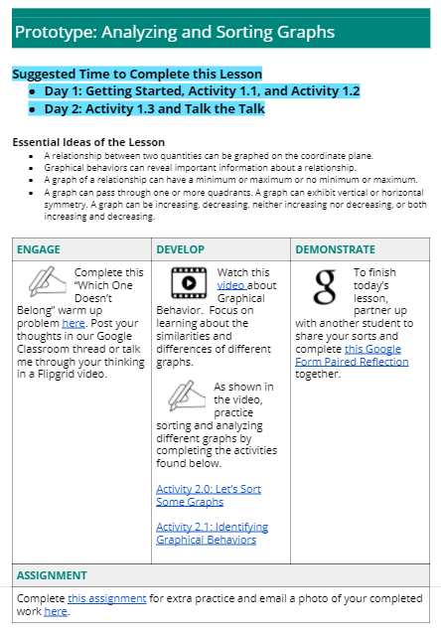
THL 3.0 Curricular Resources Are Digitized and Designed for the New Learning Environment
Component
TEKS-Aligned Plans
Assessment Tools
Teacher & Student Supports
Digital Format
Progress Monitoring
Adaptable for All Learners

Slide 15
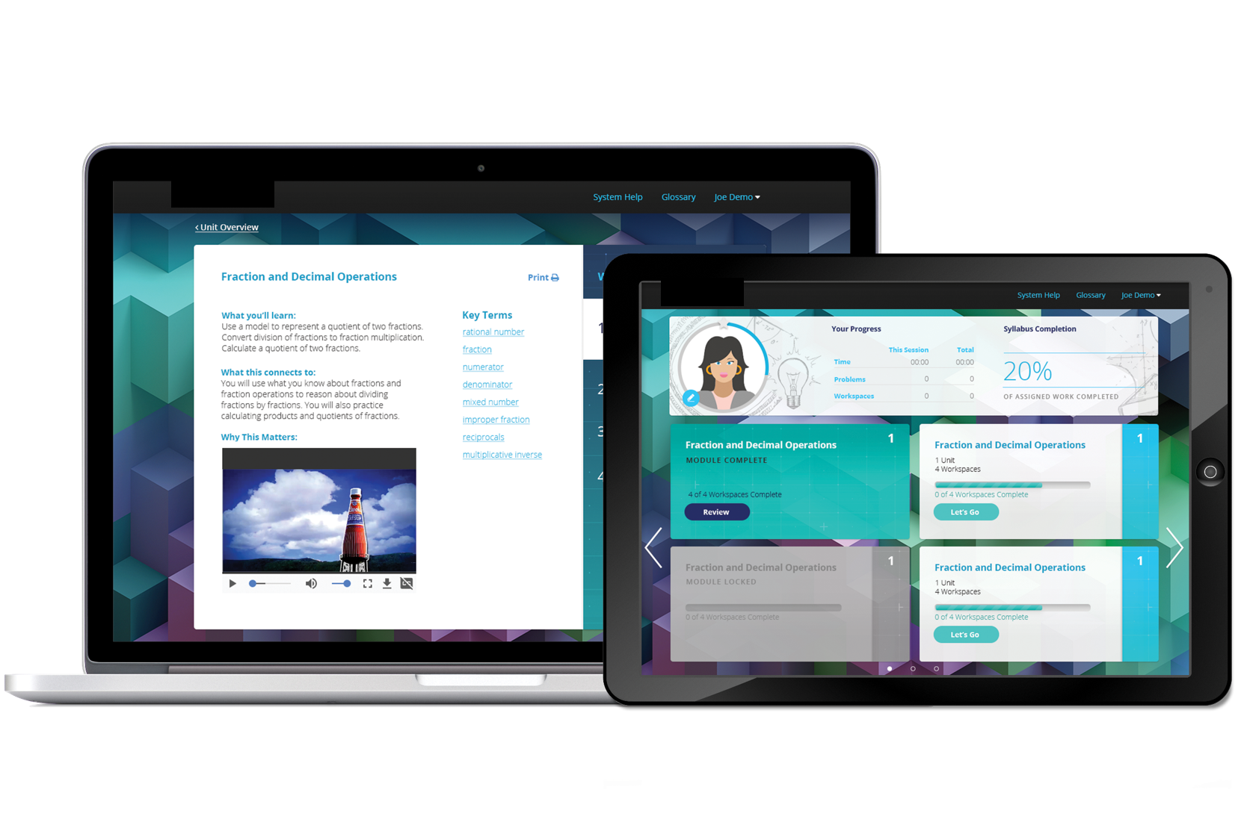
THL 3.0 Curricular Resources Are Digitized and Designed for the New Learning Environment
Component
TEKS-Aligned Plans
Assessment Tools
Teacher & Student Supports
Digital Format
Progress Monitoring
Adaptable for All Learners
Full scope and sequence with modules, embedded lessons, student practice, and assessments ready for teachers to use

Slide 16
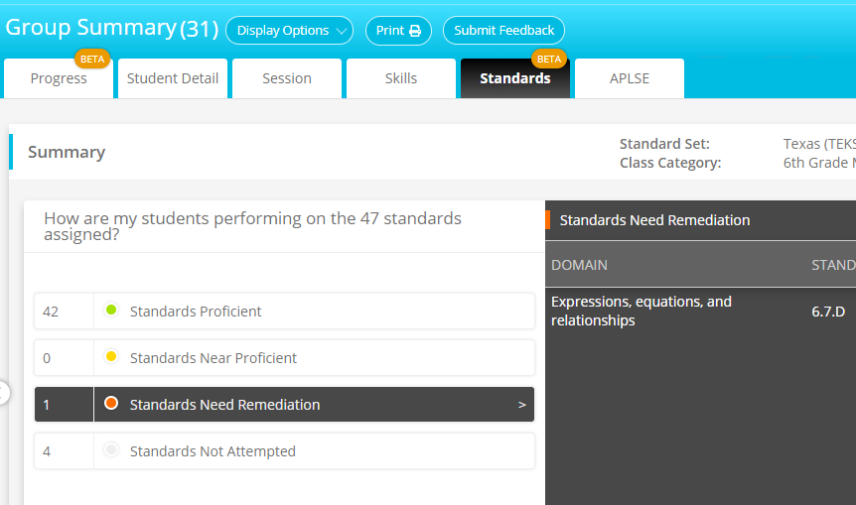
THL 3.0 Curricular Resources Are Digitized and Designed for the New Learning Environment
Component
TEKS-Aligned Plans
TEKS MASTERY OVER TIME
Assessment Tools
Teacher & Student Supports
Digital Format
Progress Monitoring
Adaptable for All Learners
Class-level view enables oversight into TEKS mastery to inform future planning

Slide 17
THL 3.0 Curricular Resources Are Digitized and Designed for the New Learning Environment
Component
TEKS-Aligned Plans
Assessment Tools
Teacher & Student Supports
Digital Format
Progress Monitoring
Adaptable for All Learners
Teacher notifications provide helpful information about students who mastering content and those who need targeted supports

Slide 18
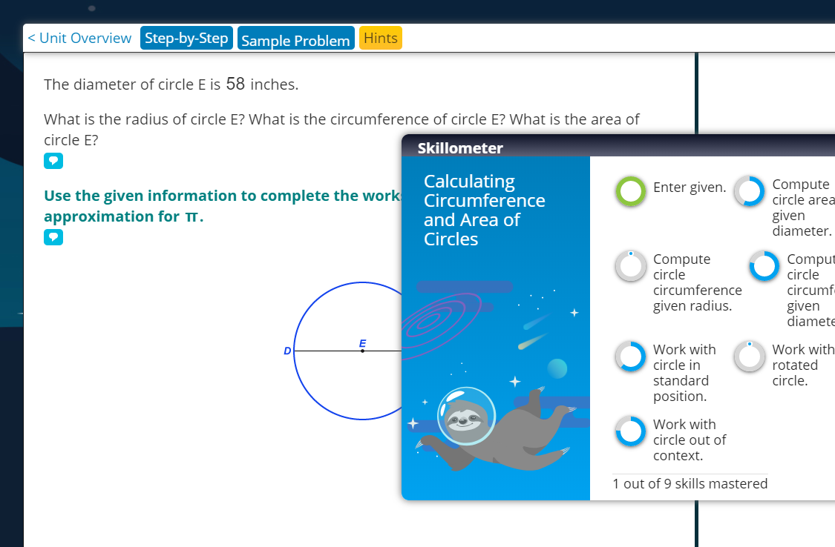
THL 3.0 Curricular Resources Are Digitized and Designed for the New Learning Environment
Component
TEKS-Aligned Plans
Assessment Tools
Teacher & Student Supports
Digital Format
Progress Monitoring
Adaptable for All Learners
Student can view skills that are mastered and those in progress from both at-home and in-school environments

Slide 19
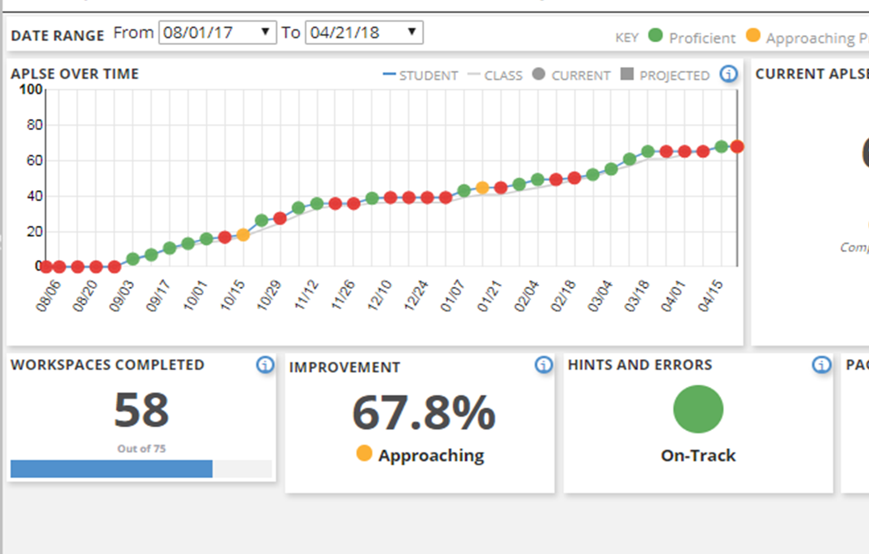
THL 3.0 Curricular Resources Are Digitized and Designed for the New Learning Environment
Component
TEKS-Aligned Plans
TEKS MASTERY OVER TIME
Assessment Tools
Teacher & Student Supports
Digital Format
Progress Monitoring
Adaptable for All Learners
Quick and simple overview of progress towards TEKS mastery throughout the school year

Slide 20
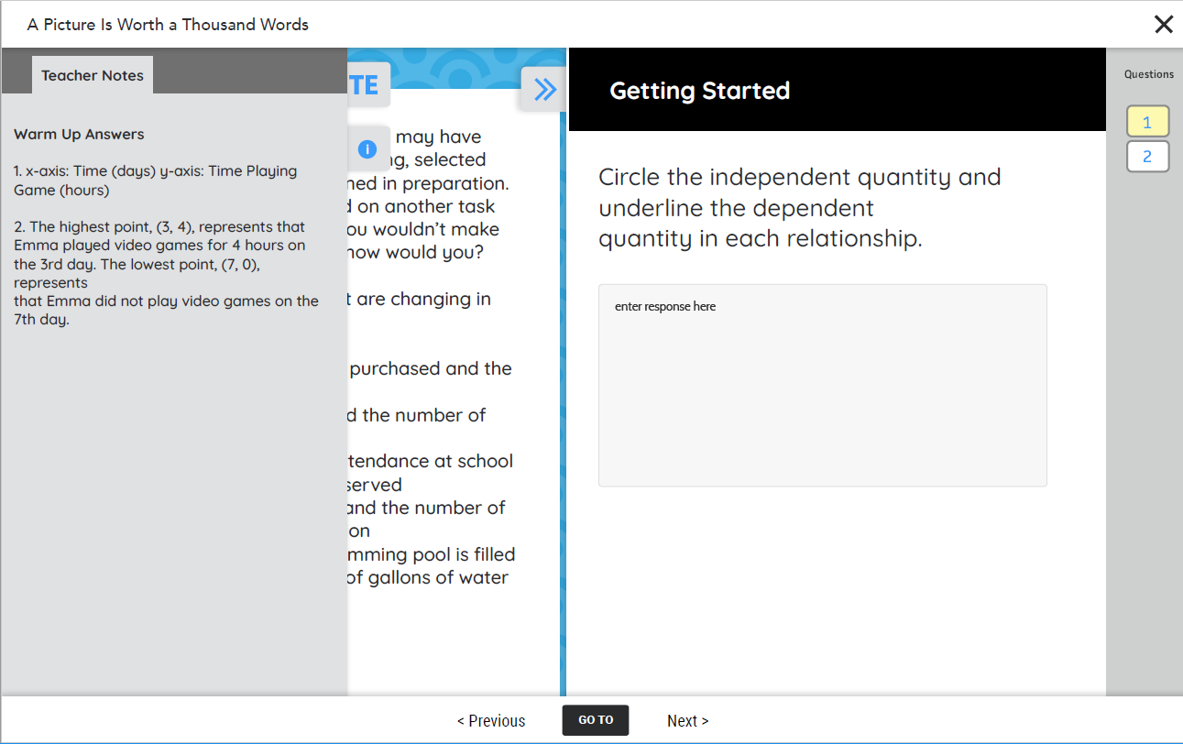
THL 3.0 Curricular Resources Are Digitized and Designed for the New Learning Environment
Component
TEKS-Aligned Plans
Assessment Tools
Teacher & Student Supports
Digital Format
Progress Monitoring
Adaptable for All Learners
Adaptive software helps students progress on individualized pathways towards grade level mastery and beyond

Slide 21
THL curricular resources are being developed specifically for Texas schools in this new learning environment
Develop
THL curricular resources are being developed specifically for Texas schools in this new learning environment
Review
Texas teachers will be involved in a TEKS and quality review process before release of each set of materials
Continuous improvements will be made to materials on ongoing basis
Release
Once approved, materials will be available through Schoology, as standalone resources or through other learning or content management systems
Support
Support district adapt or adoption decisions
Product specific webinars and onboarding trainings
Ongoing product improvements and supports for implementation

Slide 22
THL curricular resources are being developed specifically for Texas schools in this new learning environment
Develop
THL curricular resources are being developed specifically for Texas schools in this new learning environment
Review
Texas teachers will be involved in a TEKS and quality review process before release of each set of materials
Continuous improvements will be made to materials on ongoing basis
Release
Once approved, materials will be available through Schoology, as standalone resources or through other learning or content management systems
Support
Support district adapt or adoption decisions
Product specific webinars and onboarding trainings
Ongoing product improvements and supports for implementation

Slide 23
We need your help to nominate great teachers to join to the THL instructional materials review team
Profile
Texas teacher certification
Content expertise for participating subjects including experience with Sped, GT, or ELLs
Experience with and commitment to using high quality materials and achieving academic results with kids
Responsibilities
Spend 4-6 hours per month reviewing materials, attending focus groups, and providing feedback for the materials
Adopt and use THL materials in their classrooms and provide feedback on an ongoing basis
Nominate a teacher or school/district leader by sending their name and email address to texashomelearning@tea.texas.gov with “Teacher Nominee” as subject

Slide 24
THL curricular resources are being developed specifically for Texas schools in this new learning environment
Develop
THL curricular resources are being developed specifically for Texas schools in this new learning environment
Review
Texas teachers will be involved in a TEKS and quality review process before release of each set of materials
Continuous improvements will be made to materials on ongoing basis
Release
Once approved, materials will be available through Schoology, as standalone resources or through other learning or content management systems
Support
Support district adapt or adoption decisions
Product specific webinars and onboarding trainings
Ongoing product improvements and supports for implementation

Slide 25
Instructional Materials and Technology Release Schedule
Materials available:
LMS and other technology materials
Unit 1 instructional materials and lesson plans in most subjects
Instructional materials and technology professional development
Materials available:
Unit 3 instructional materials and lesson plans
Instructional materials and technology professional development
Materials available:
Unit 5 instructional materials and lesson plans
Instructional materials and technology professional development
AUG
SEP
OCT
NOV
DEC
Materials available:
Unit 2 instructional materials and lesson plans in most subjects
Instructional materials and technology professional development
Once made available, districts can adopt materials at any time throughout the year
Materials available:
Unit 4 instructional materials and lesson plans
Instructional materials and technology professional development

Slide 26
Looking Forward with Texas Home Learning
Subject | Grades Offered
Integrated | Pre-K
Math | K- 12th
ELAR | K- 12th
SLAR | K-5th
Science | K-5th
SS | K-5th
College Prep | 12th
Dyslexia & Speech Tools | All
Product Specific Webinars
Announce and give overview of product
Preview of teacher and student materials
Summary of implementation supports and trainings included to support use of the THL product
Mark your calendars:
6-12 Math: Tuesday, 8/25 at 1pm CT
K-5 Math: Wednesday 8/26 at 1pm CT
Instructional Materials Release
Instructional materials posted on vendor website and linked through texashomelearning.org
Mark your calendars:
K-12 Math: Monday, 8/31
Webinar info and release details to be communicated through superintendent listserv and texashomelearning.org

Slide 27
THL 3.0: College Prep Math and College Prep English

Slide 28
Disruptions in learning from COVID increased disparities in College Readiness for millions of Texas students
Disparities in Equity in CCMR
Spring 2020 Disruption in Instruction
Changing College Admission Requirements
Less than 50% of our African American, Hispanic, Eco. Dis, ELLs, and SpEd students graduated college, career, or military ready
COVID 19 and the spring of 2020 delivered an unprecedented disruption to ACT, SAT, and TSIA testing
IHEs maintain flexibility in determining college readiness
and college admission requirements change from year to year
28

Slide 29
What is Texas College Bridge?
Online College Readiness Curriculum
Simultaneous Supports
Online College and Career Supports and Tools
Online, alternative course option for College Prep math and English
Competency-based progression aligned with college readiness exams like ACT, SAT, & TSIA
Dashboards to monitor and adjust student progress
Student-facing college and career planning tools, activities, and trackers
Information resources and guides for college and career exploration
Training developed specifically for college and career advisors

Slide 30
Provides high school seniors an opportunity to take an online College Preparatory Course in English Language Arts or Mathematics
ISDs/Charters
No cost to districts through August 2021
Improves district A-F accountability ratings (CCMR)
Students
Self-paced, competency-based, on-line course with evidence of validity
Personalized math/ELA instruction
Completion exempts students from development education freshman level college courses for 24 months after HS graduation.
30

Slide 31
Online personalized English and math courses are currently available
Develop
Explore both courses as a student today!
Visit https://tx.edready.org/
Choose Enter as Guest
Click Enter to close the pop-up window
Enter the desired goal key: tx_math_demo or tx_English_demo
Select Go to Goal
Review
Release
Support
NROC Partnership: NROC has been producing results for over a decade and is particularly effective with low-income students

Slide 32
Detailed units and topics are currently available
Component
TEKS-Aligned Plans
Assessment Tools
Teacher & Student Supports
Digital Format
Progress Monitoring
Adaptable for All Learners
Detailed breakdown of the Units & Topics available.
32

Slide 33
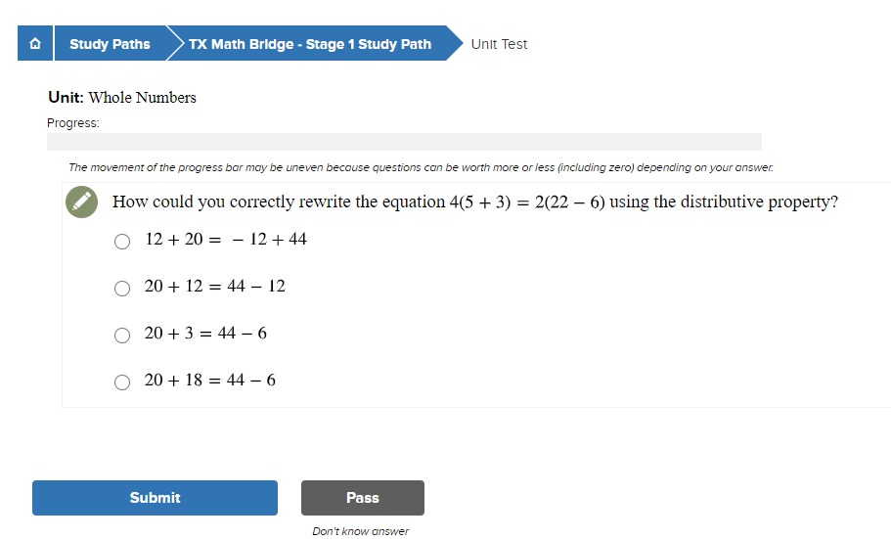
Assessment tools are provided to support teachers and students
Component
TEKS-Aligned Plans
Assessment Tools
Teacher & Student Supports
Digital Format
Progress Monitoring
Adaptable for All Learners
33

Slide 34
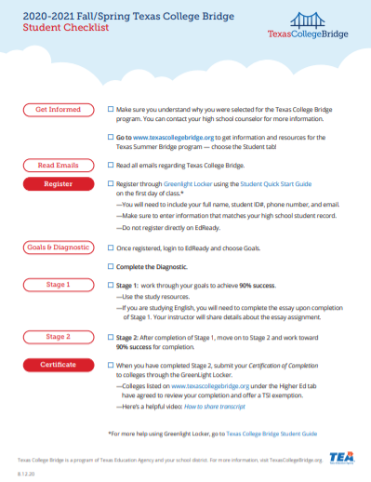
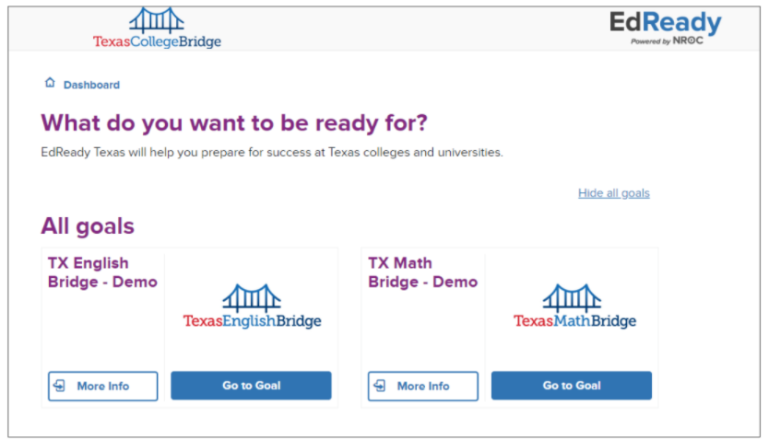
Teacher and student tools are currently available, including student checklist
Component
TEKS-Aligned Plans
Assessment Tools
Teacher & Student Supports
Digital Format
Progress Monitoring
Adaptable for All Learners
34

Slide 35
Resource can be used for on-campus instruction, remote learning, or in hybrid settings
Component
TEKS-Aligned Plans
In person
EdReady as primary material
Hybrid
EdReady and existing material
On Campus Instruction
Assessment Tools
Teacher & Student Supports
Online only
EdReady as only material
Distance learning
with teacher support
Digital Format
Remote Home Learning
Progress Monitoring
Adaptable for All Learners
35

Slide 36
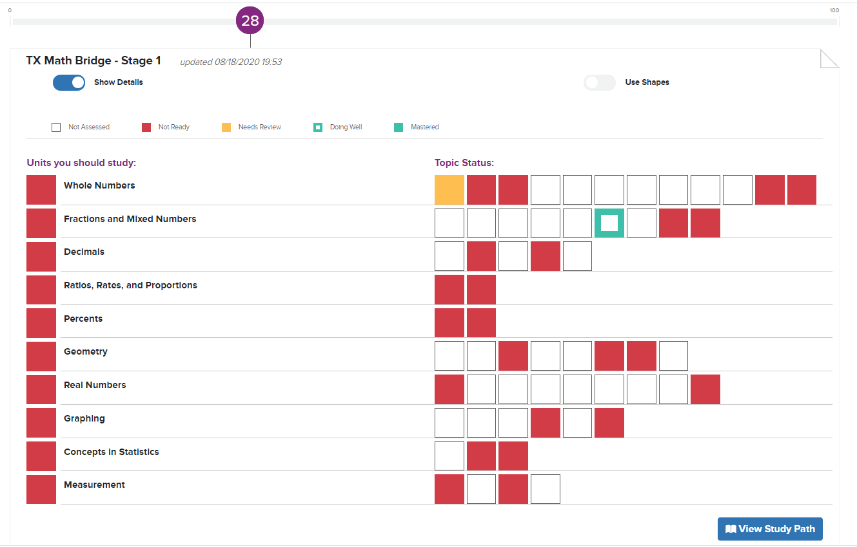
Progress monitoring tools give students and teachers clear information on course progress and mastery
Component
TEKS-Aligned Plans
Assessment Tools
Teacher & Student Supports
Digital Format
Progress Monitoring
Adaptable for All Learners
36

Slide 37
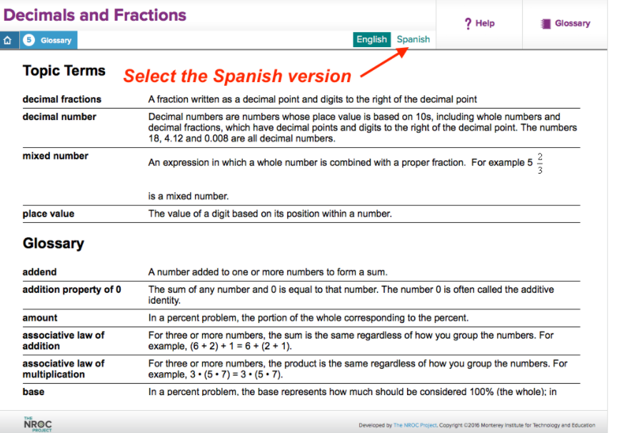
Resources are designed to support all learners
Component
TEKS-Aligned Plans
Assessment Tools
Teacher & Student Supports
Digital Format
Progress Monitoring
Adaptable for All Learners
https://vimeo.com/thenrocproject/review/229326071/4cb858e686
37

Slide 38
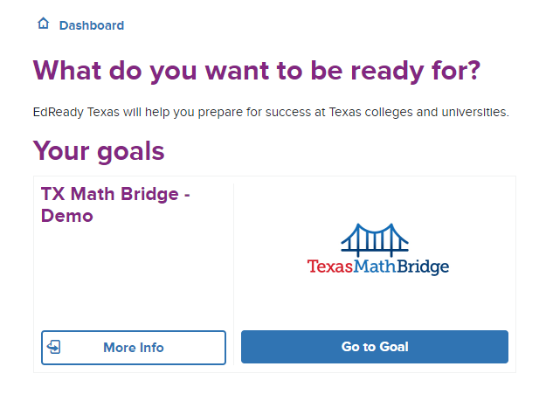
Let’s look at a demo!
Explore as a student today!
Visit https://tx.edready.org/
Choose Enter as Guest
Click Enter to close the pop-up window
Enter the desired goal key: tx_math_demo or tx_English_demo
Select Go to Goal

Slide 39
College Prep Courses are developed in conjunction with an IHE
Develop
Partner with an Institution of Higher Education (IHE) to develop/provide course
Designed for students at the 12th grade level whose performance:
On end-of-course assessment does not meet college readiness standards
Coursework, a college entrance exam, or the TSIA, is not ready to perform entry-level college coursework
Provide notice to student and student’s parent/guardian regarding the benefits of enrolling
Upon course completion a student:
Is exempt from developmental education for 24 months following the date the student graduates from high school*
The exemption is valid only at the IHE that partners with the school district*
Review
Release
Support
*TEC §28.014 and 51.338

Slide 40
College Preparatory Courses need an MOU with an IHE
The partnership with an IHE may be accomplished in one of two ways:
1. Local ISD/IHE Partnership MOU
ISD/IHE review the Texas College Bridge instructional materials.
Determine if curriculum meets the IHE’s college readiness standards.
Amend current MOU to incorporate the Texas College Bridge online courses as the college preparatory mathematics and/or English language arts courses
2. Texas College Bridge MOU
ISD/IHE review the Texas College Bridge instructional materials.
Determine if curriculum meets the IHE’s college readiness standards
Review the Texas College Bridge MOU and faculty review documents
IHE/ISD sign onto the Texas College Bridge MOU

Slide 41
Higher Education Partners
Dallas County Community College
University of North Texas
University of North Texas at Dallas
Texas A&M University at Commerce
Texas Woman’s University
Odessa College
Panola College
Vernon College
Blinn College
MOU available at: www.texascollegebridge.org
as of August 17, 2020

Slide 42
These materials are currently released and accepting enrollment for Fall 2020
Develop
Review
Graduating seniors who have not demonstrated a CCMR measure (ACT, SAT,TSIA, College Prep course etc.)
Seniors who are taking HB 5 College Prep Courses
Graduating/rising seniors who have not demonstrated a CCMR measure (ACT, SAT, TSIA, etc.)
Summer 2020 Phase 1
Fall and Spring 2020-2021
Phase 2
Summer 2021
Phase 3
Release
Complete
Support
Accepting Enrollment

Slide 43
Next steps for Fall 2020 enrollment
Complete the enrollment form at texascollegebridge.org (click on District)
Texas College Bridge team members will contact you
Determine District start date (next class start date is September 28)
Determine district implementation plan
Complete Fall Action Steps
Fall Action Steps | Fall Option 1 | Fall Option 2 | Fall Option 3 | Fall Option 4
Application/Interest website form submitted by: | Aug 4 | Sep 7 | Oct 5 | Nov 2
Participation, Data Sharing & Requirements Agreement submitted by: | Aug 10 | Sep 14 | Oct 12 | Nov 9
Roster Submission by: | Aug 17 | Sep 21 | Oct 19 | Nov 16
Classes Available to Start: | Aug 24 | Sep 28 | Oct 26 | Nov 30

Slide 44
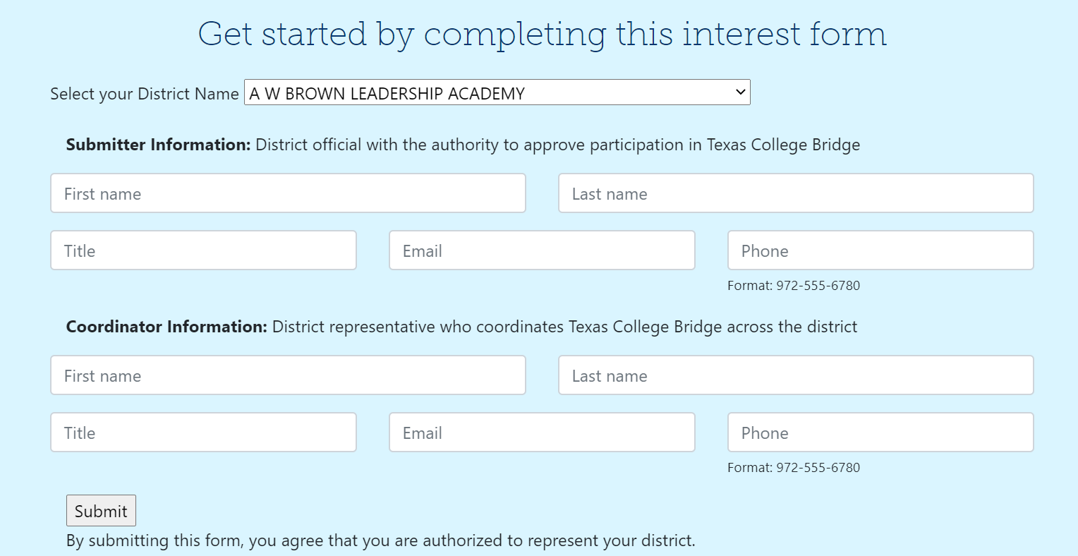
An interest form is available to start these steps

Slide 45
Supports for College Prep Math and English are currently available and college and career supports will launch 8/24
The program will provide college and career information to navigate the path to enrollment while completing College Prep coursework. All resources will link from the Texas College Bridge website and students' EdReady dashboard.
Student Resources
Student learning experience developed by College Forward
Seamless navigation from student's EdReady dashboard
6 units aligned to college and career preparation milestones
Educator Resources
Educator learning experience developed by Texas OnCourse
15 topical modules aligned to student resources and milestones
Appropriate for educators new to postsecondary advising or for those seeking to update and refresh advising knowledge
Develop
Review
Release
Support

Slide 46
College Prep Math and English Implementation Supports Available
Electronic Agreements
Participation, data sharing, and requirements agreements available on website
District Supports
Supports available to assist districts in designing local implementation plan based on district needs and best practices
Teacher Training
On-demand teacher training designed with flexibility and a remote environment in mind
Online Tools
Online resources for students, teachers, districts, and IHEs
Implementation guide, curriculum documents, videos, case studies, and more
46

Slide 47
Texas Home Learning 3.0 Recap and Next Steps

Slide 48
Next Steps and Contact Information
Math
Website: https://texashomelearning.org/
Email: TexasHomeLearning@tea.texas.gov
Next Steps:
Mark your calendar and look for call in information for next week, 8/25 and 8/26, along with materials release 8/31
Nominate a teacher or school/district leader by sending their name and email address to texashomelearning@tea.texas.gov with “Teacher Nominee” as subject
College Bridge
Website (can be accessed through the Texas Home Learning Site): www.texascollegebridge.org
Email: TexasCollegeBridge@tea.texas.gov
Next Steps: Complete the enrollment form at texascollegebridge.org

